Slide 1
Java Class
Day 11

Slide 2





Jul
Aug
TOEIC(7/24) 6/6~7/11
TEPS(7/16) 6/29~7/12
TOEIC(8/07) 6/20~7/25
TOEIC(8/21) 7/ 4 ~ 8/ 8
TEPS (8/06) 6/20~7/17
TEPS (8/20) 7/ 4 ~7/31
Big Data Analyst(10/1)
8/29~9/2
ADsP(8.28) 8/1~8/5
www.toeic.co.kr
www.teps.or.kr
www.dataq.or.kr
austin.sogang.ac.kr
austiny.snu.ac.kr

Slide 3
Mon
Tue
Wed
Thu
1. Main
Fri
1. Recap Sub
2. Main
2.
3. Main
3.
4. Main
4.
LUNCH
LUNCH
5. Sub
5. Recap Main
6. Sub
6.
7. Sub
7.
8. Recap, Test
8. Test
Jul
Aug
Java Basic
HTML, CSS, JS
Java Intermediate
Database

Slide 4
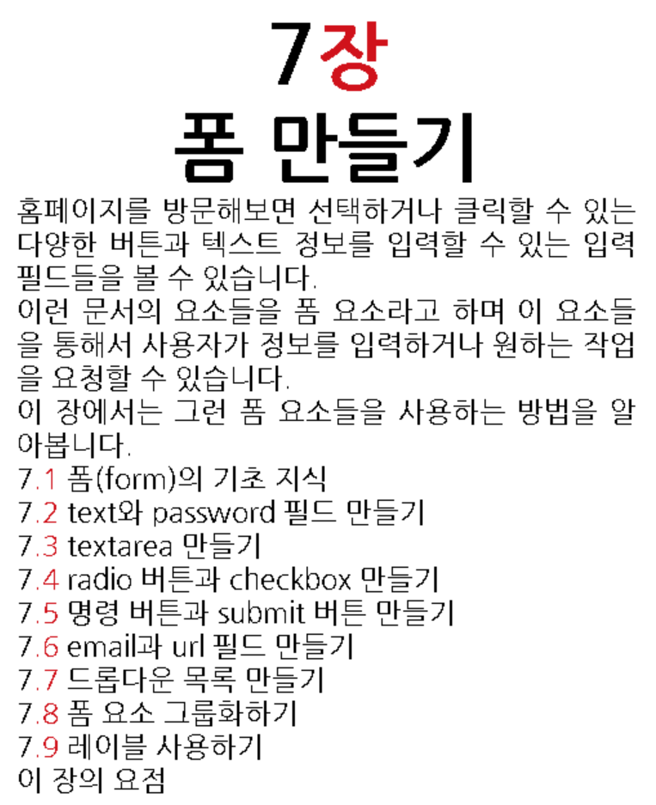
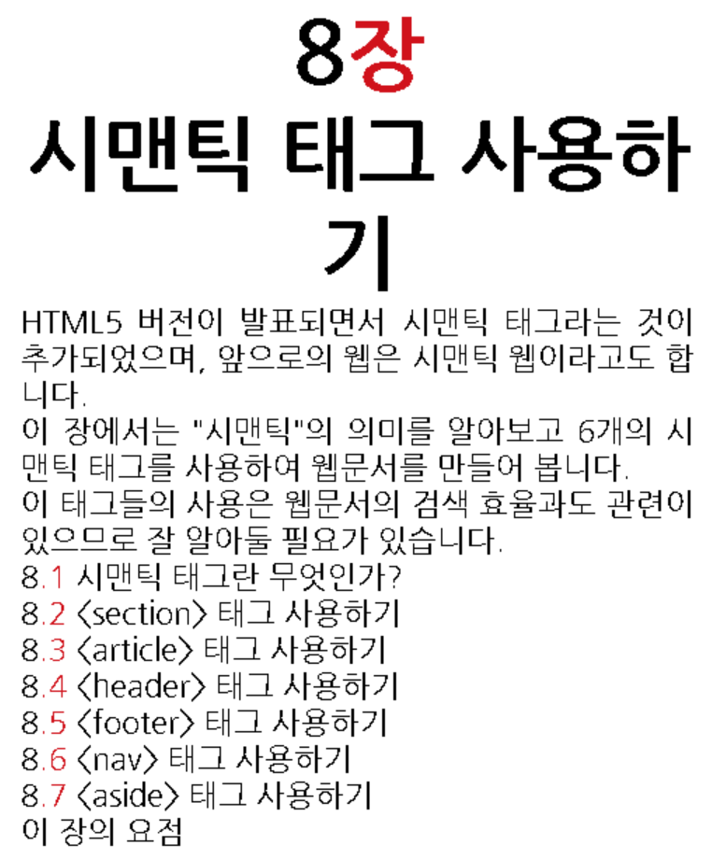
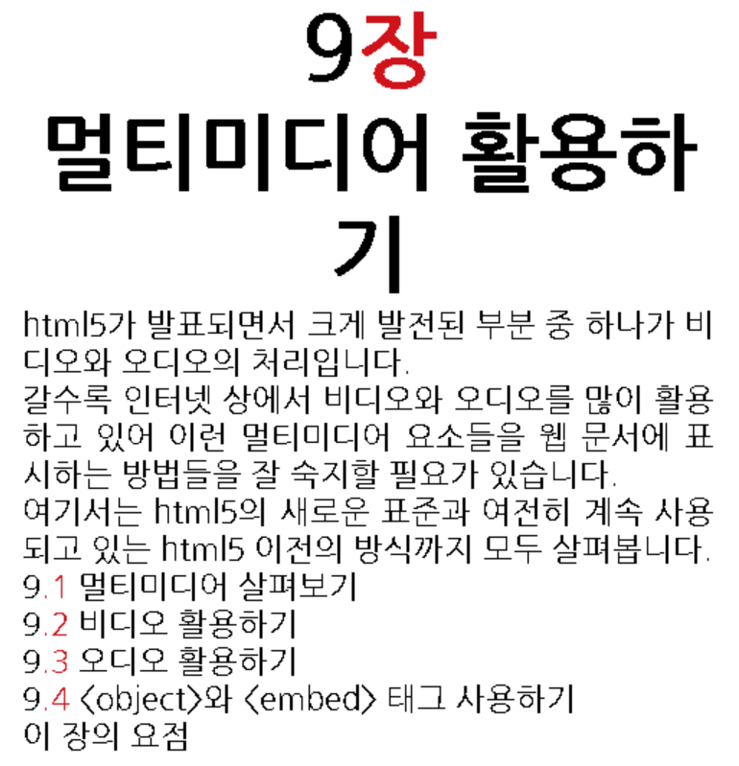
HTML

Slide 5
Java
14 Collection & Generic
14.1 Collection
14.1.1 Basic
14.1.2 Advance
14.2 Generic
14.2.1 Basic
14.2.2 Advance
14.3 Exam

Slide 7
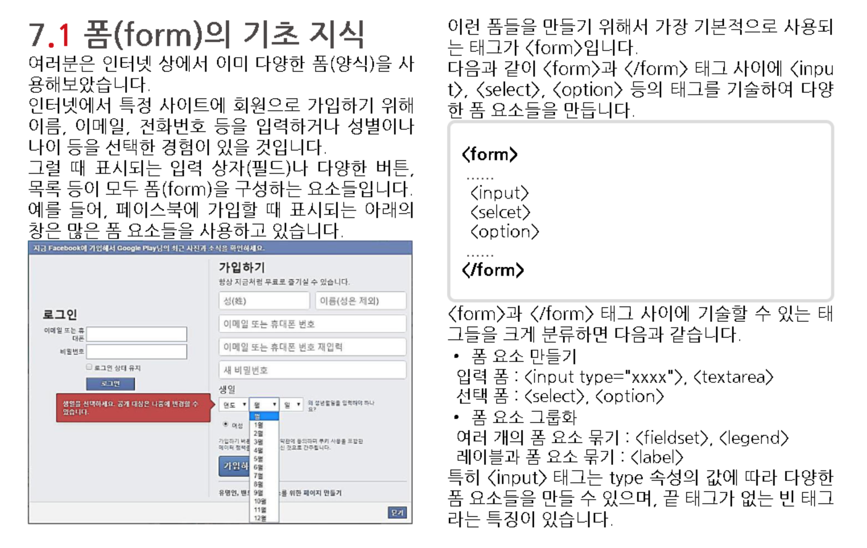

Slide 8
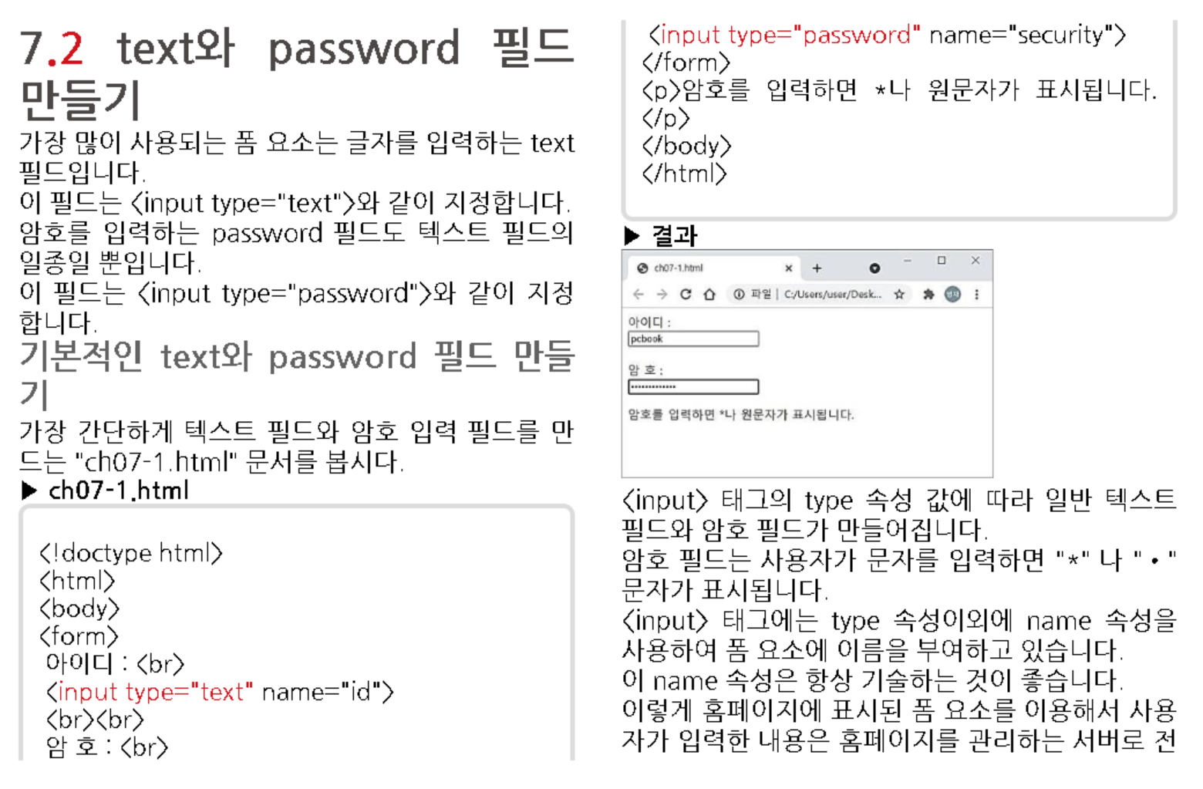

Slide 9
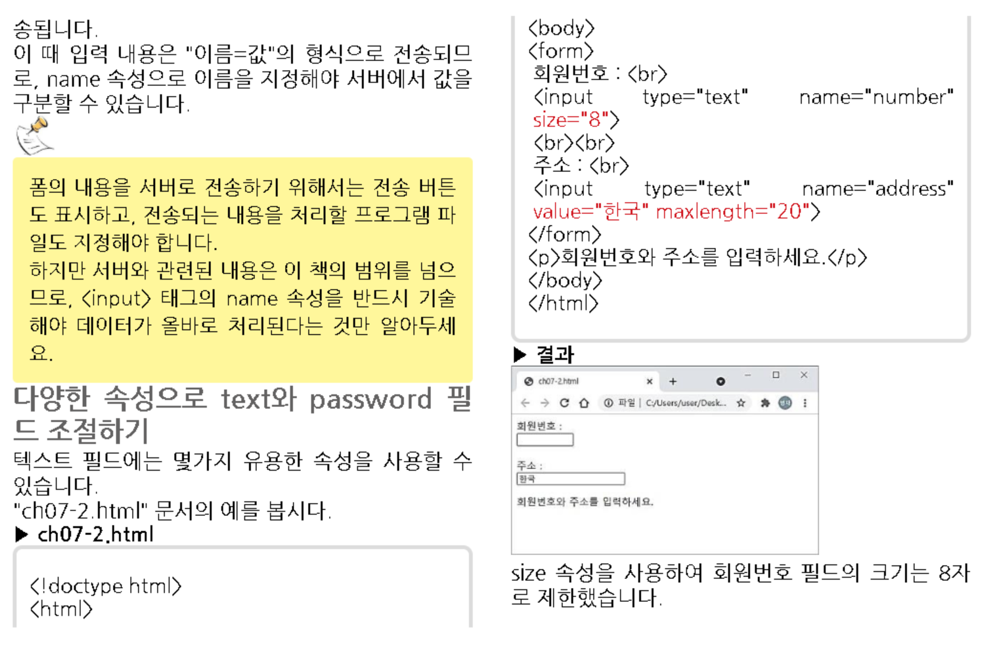
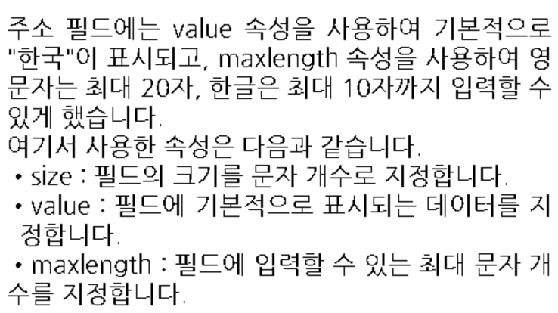

Slide 10
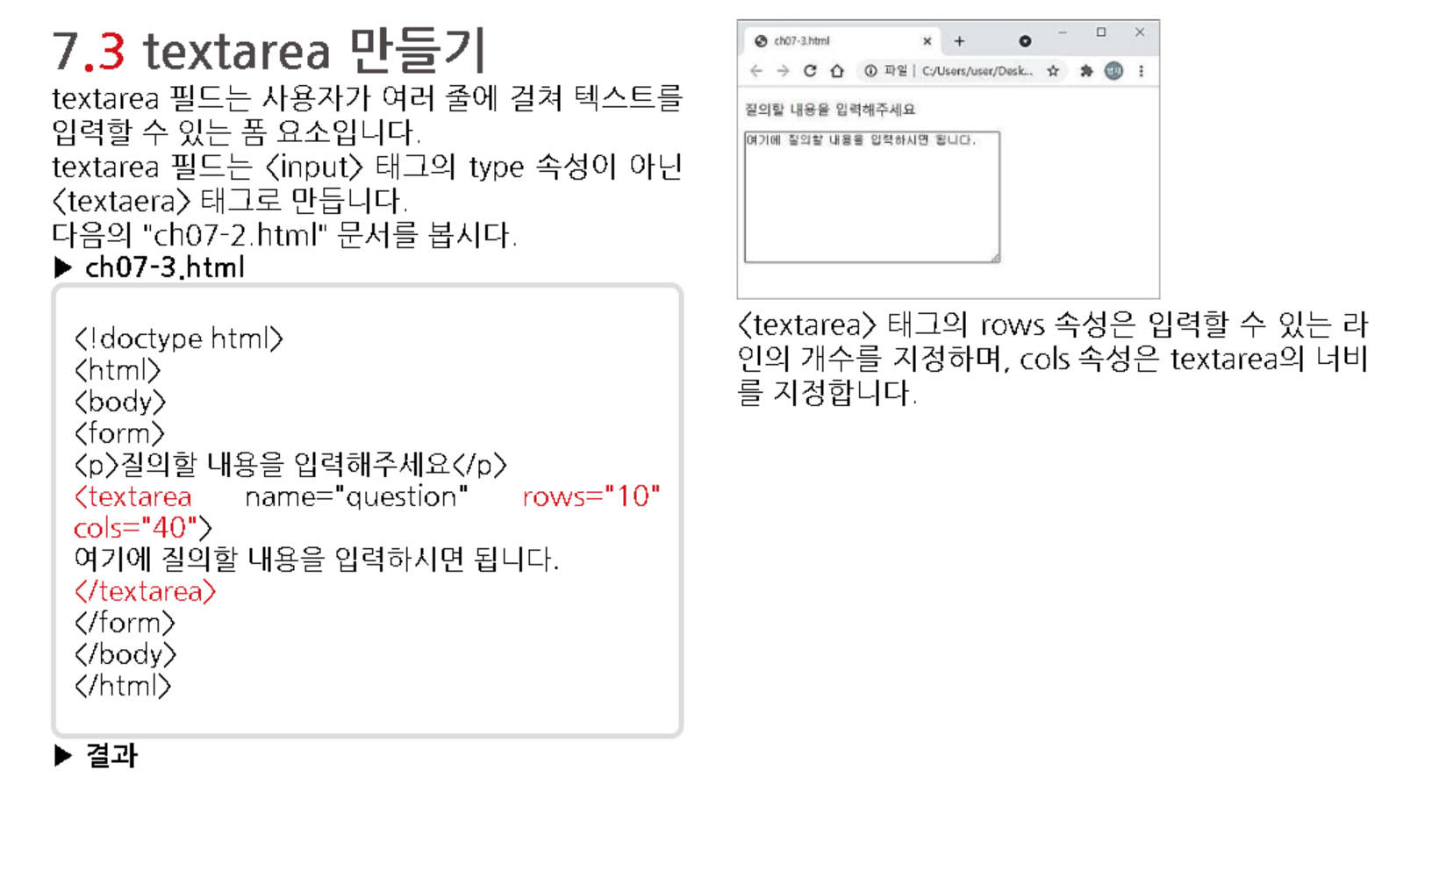

Slide 11
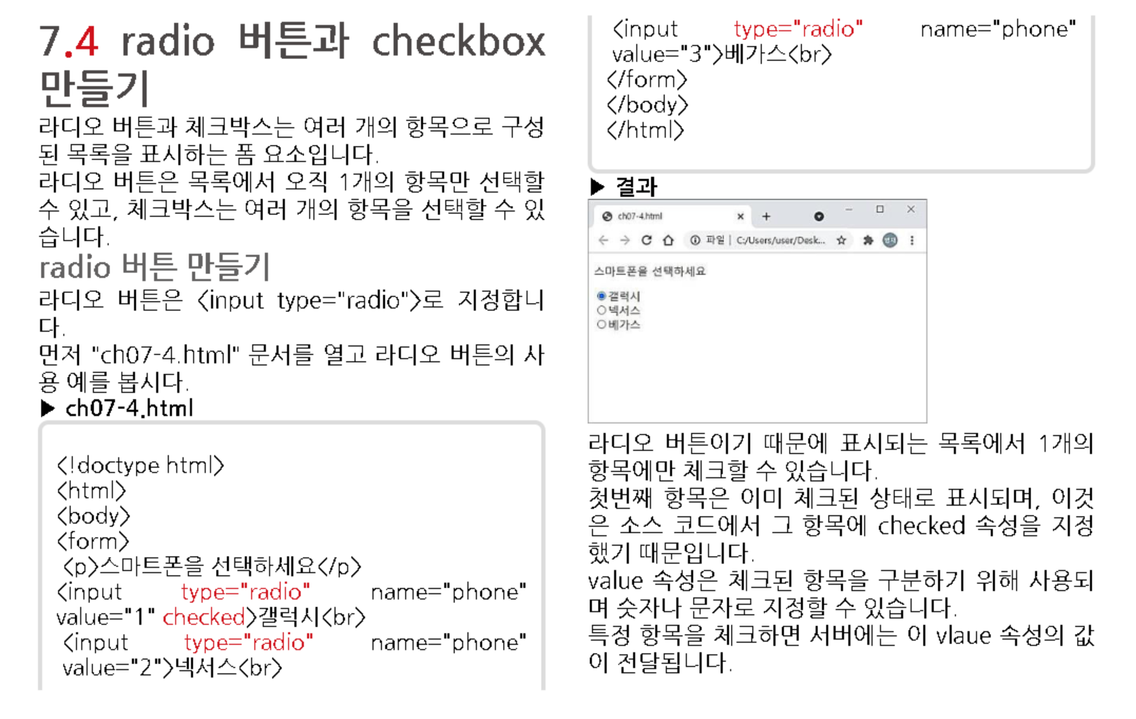

Slide 12
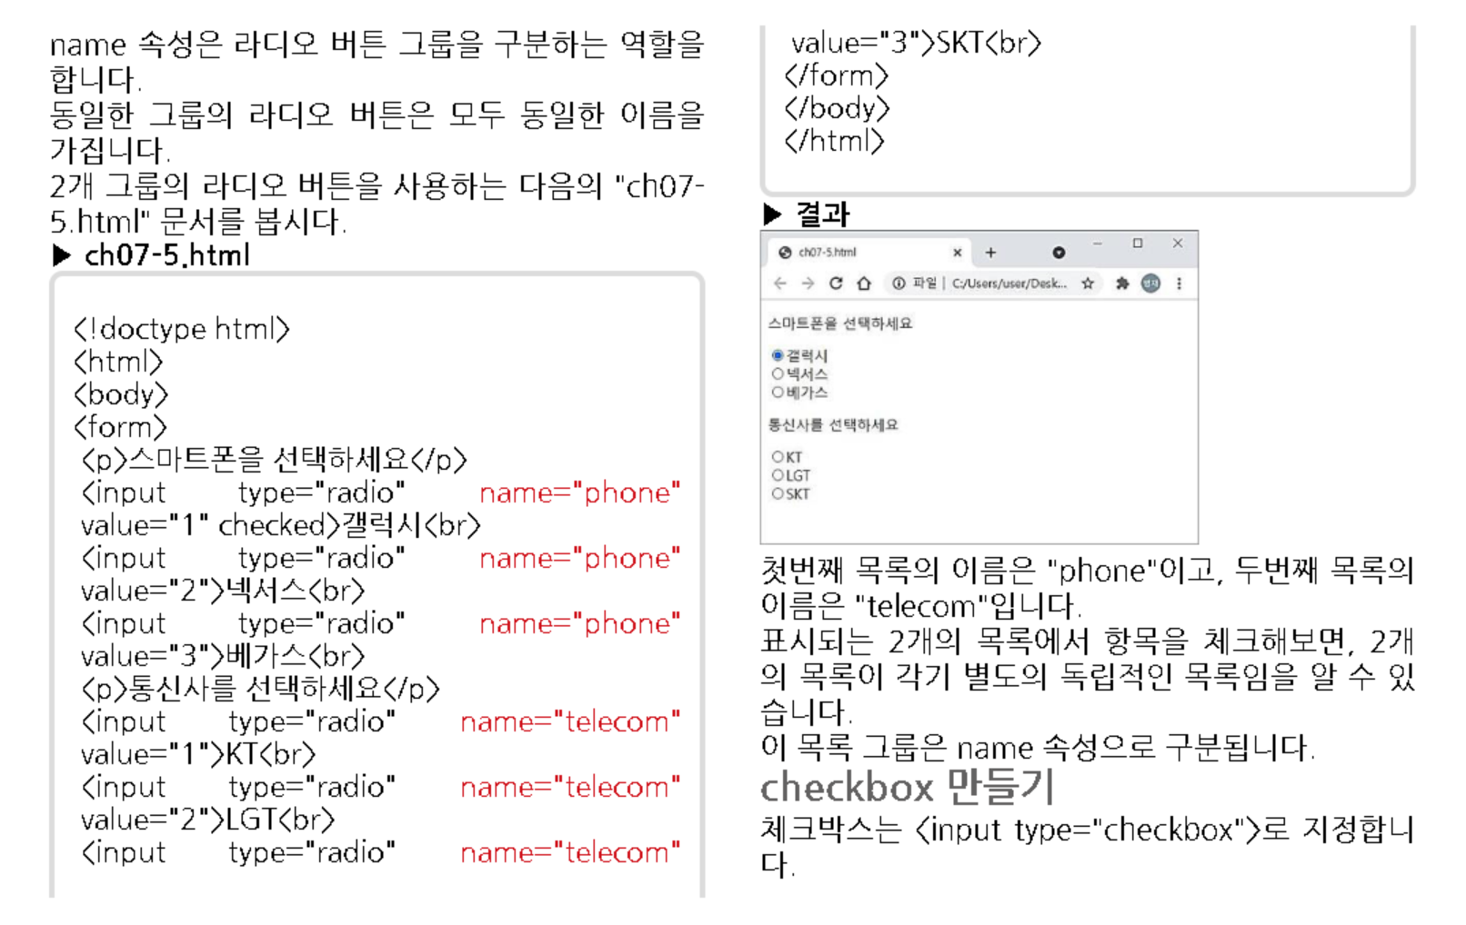

Slide 13
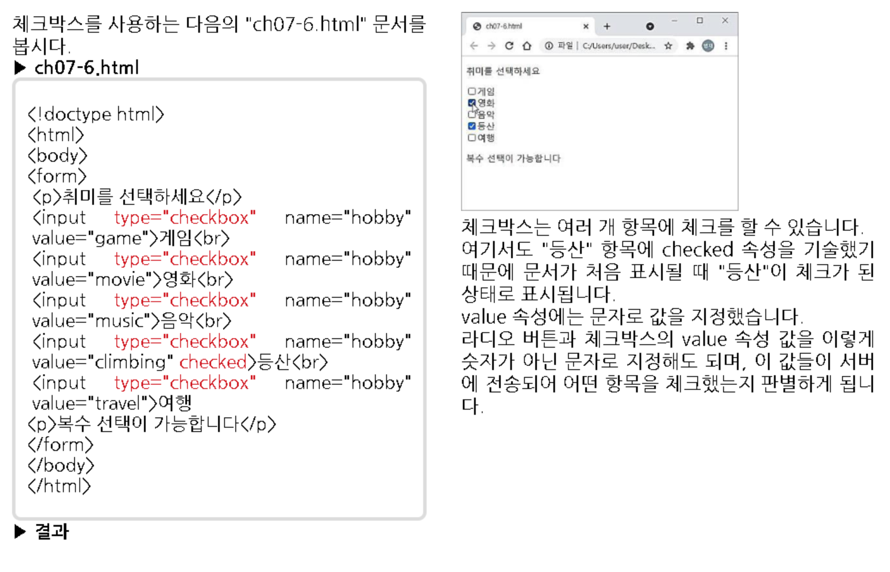

Slide 14
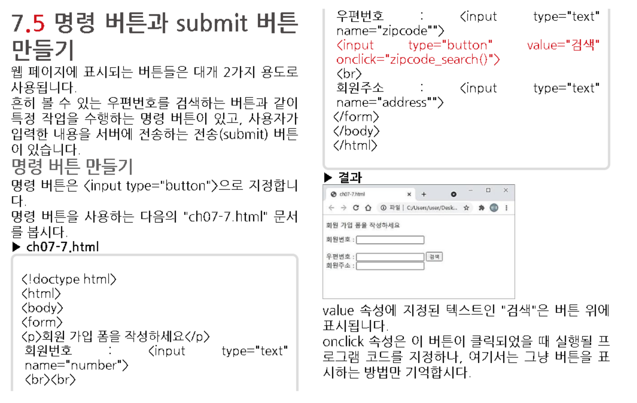

Slide 15
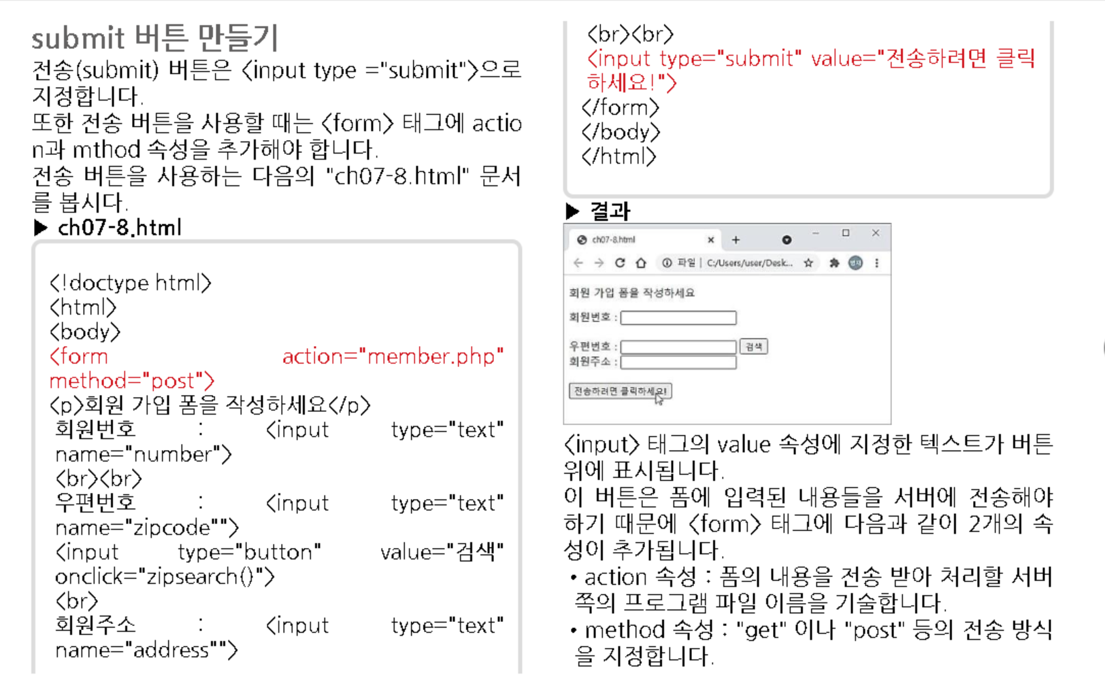

Slide 16
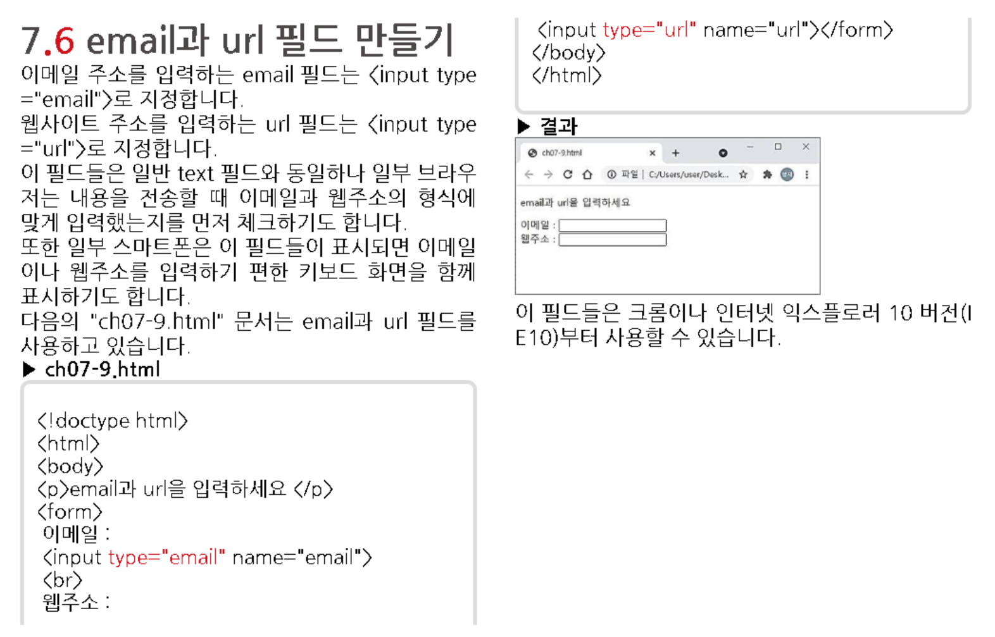

Slide 17
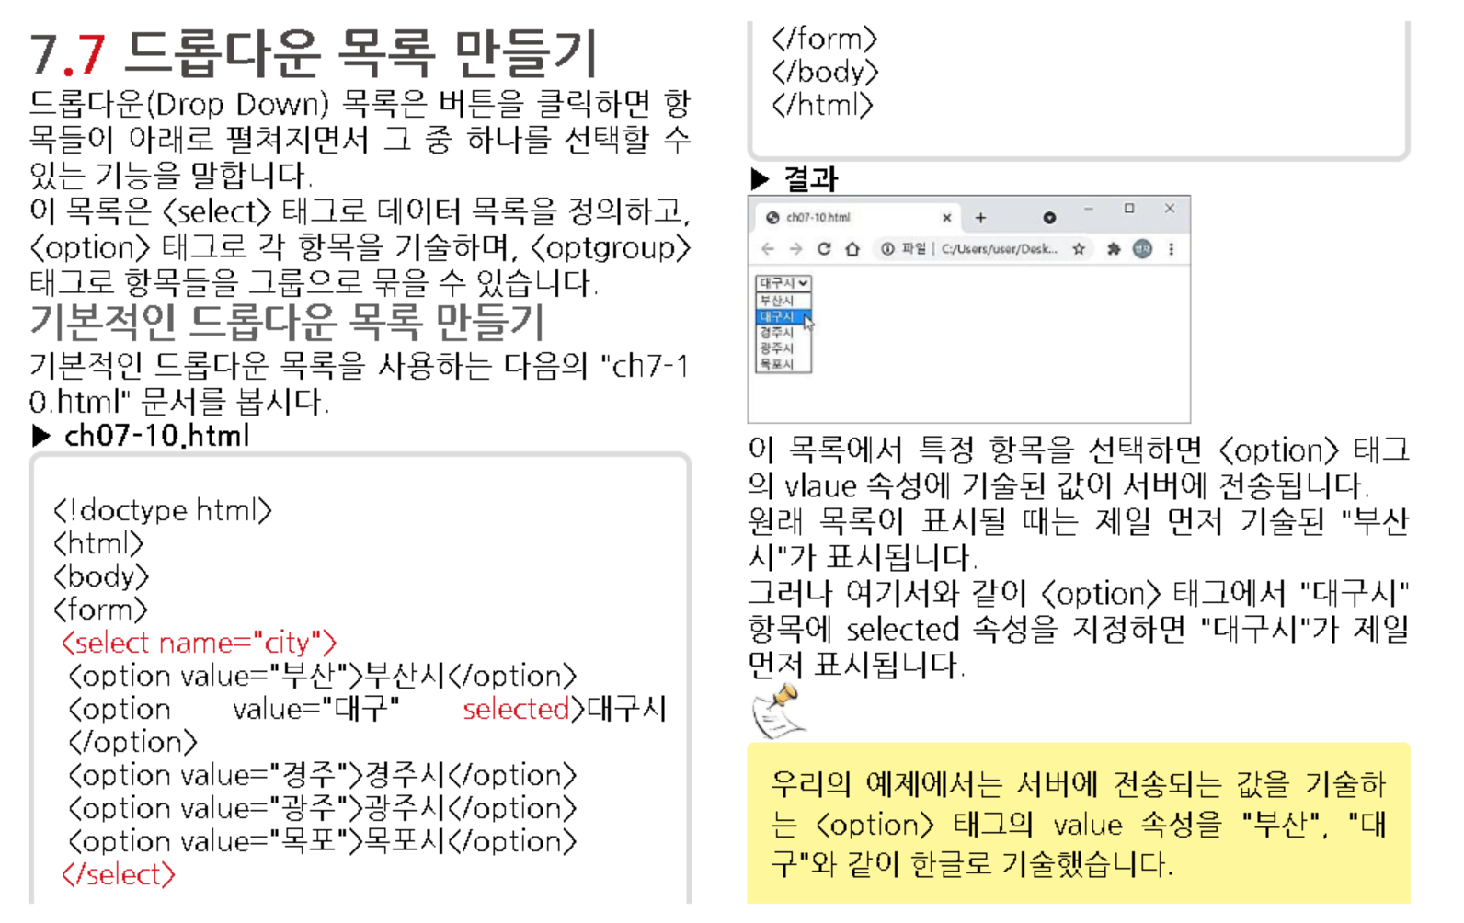

Slide 18
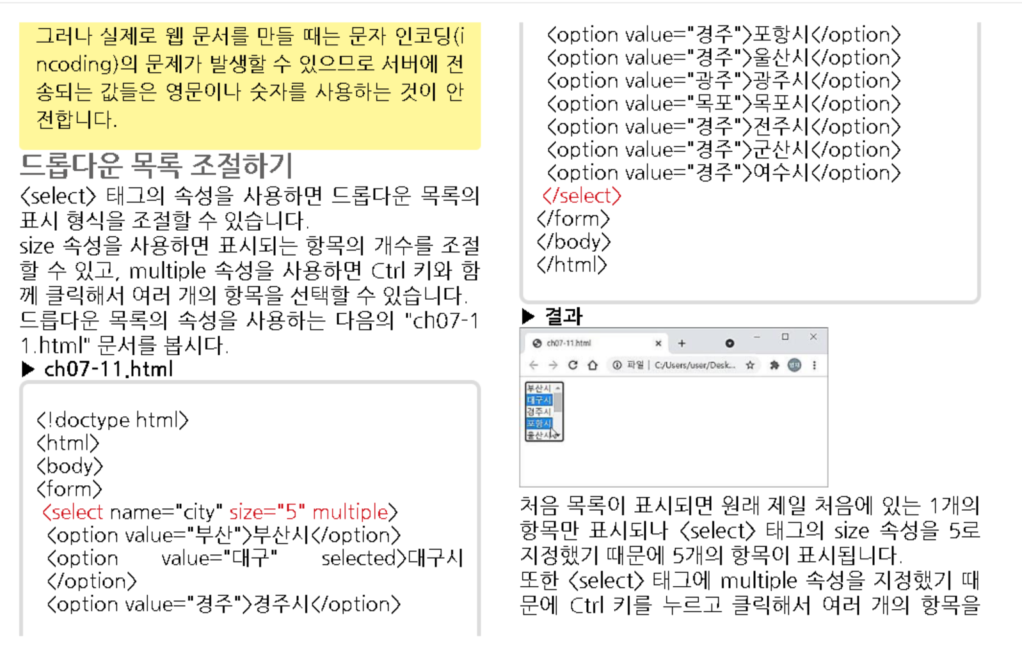

Slide 19
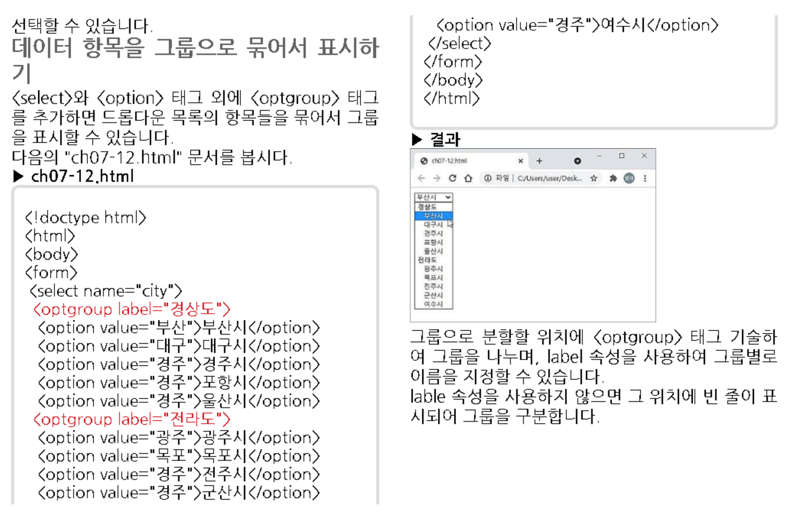

Slide 20
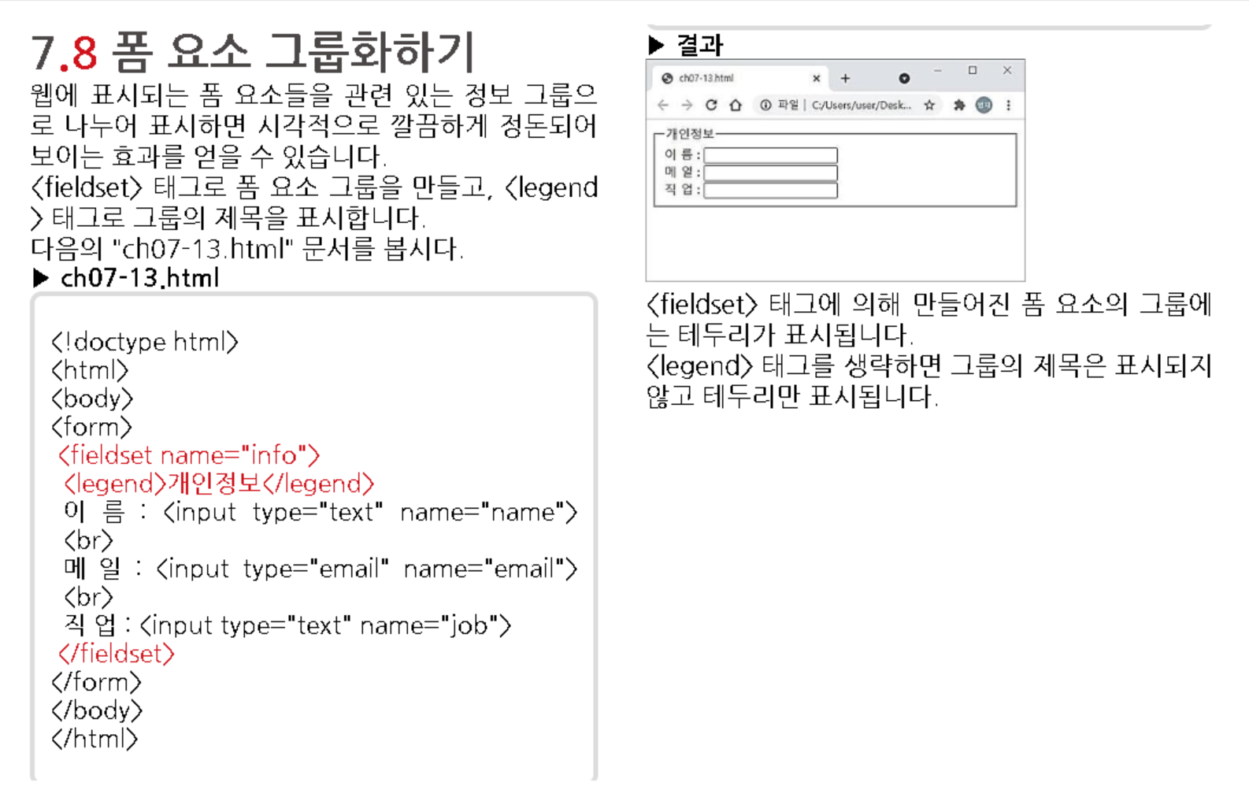

Slide 21
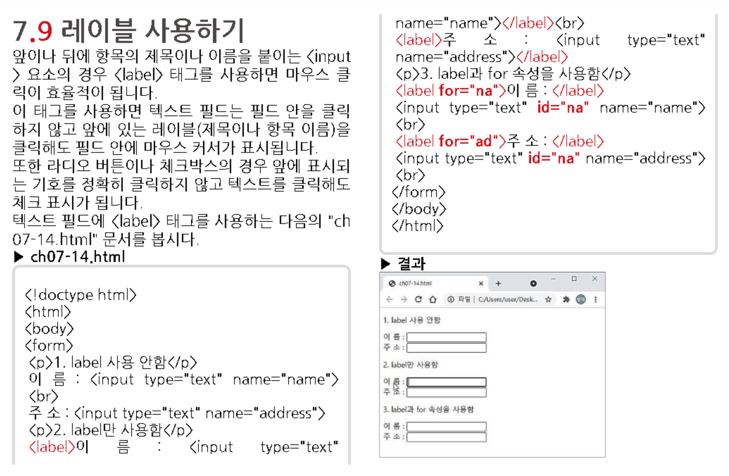

Slide 22
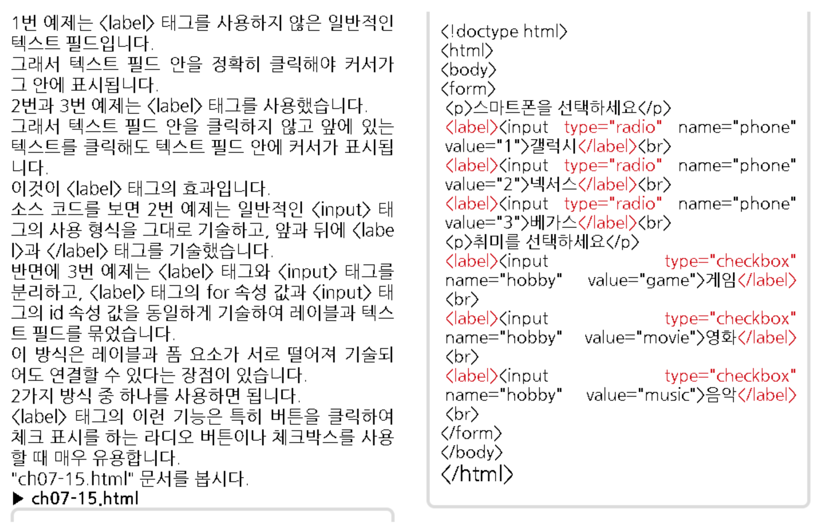

Slide 23
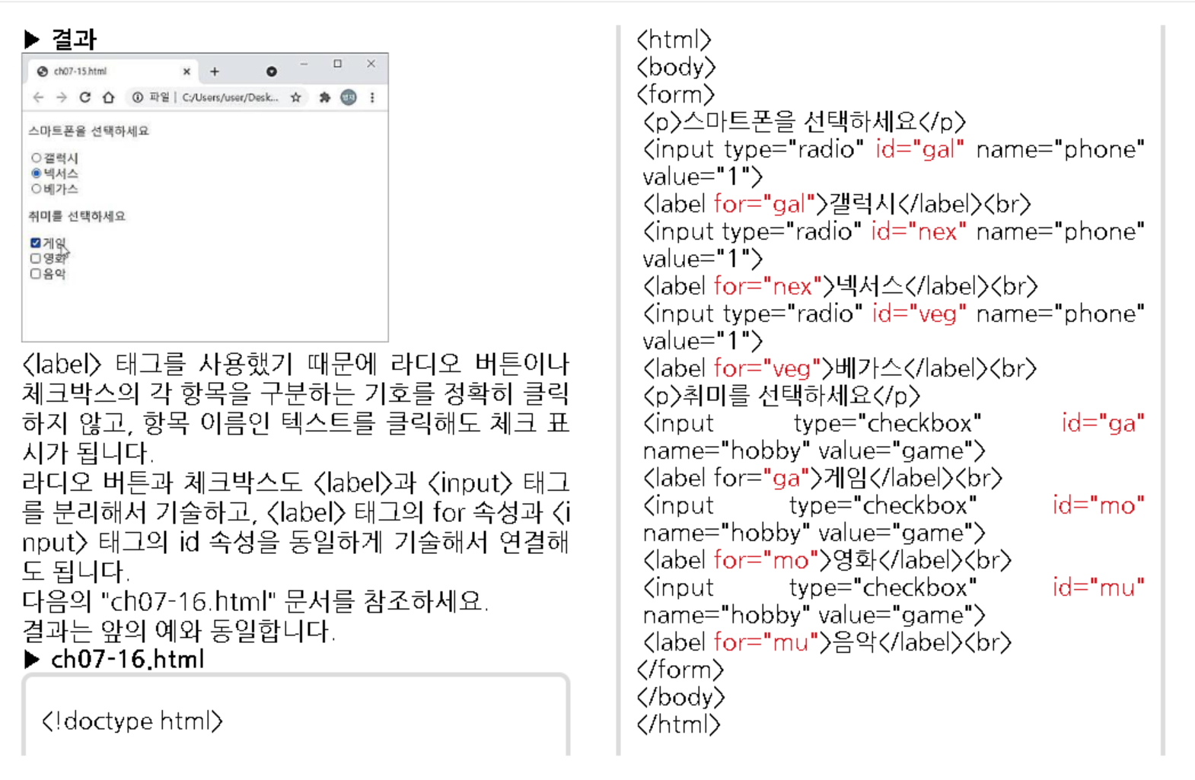
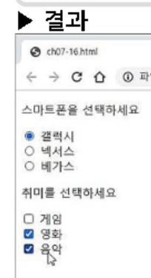

Slide 24
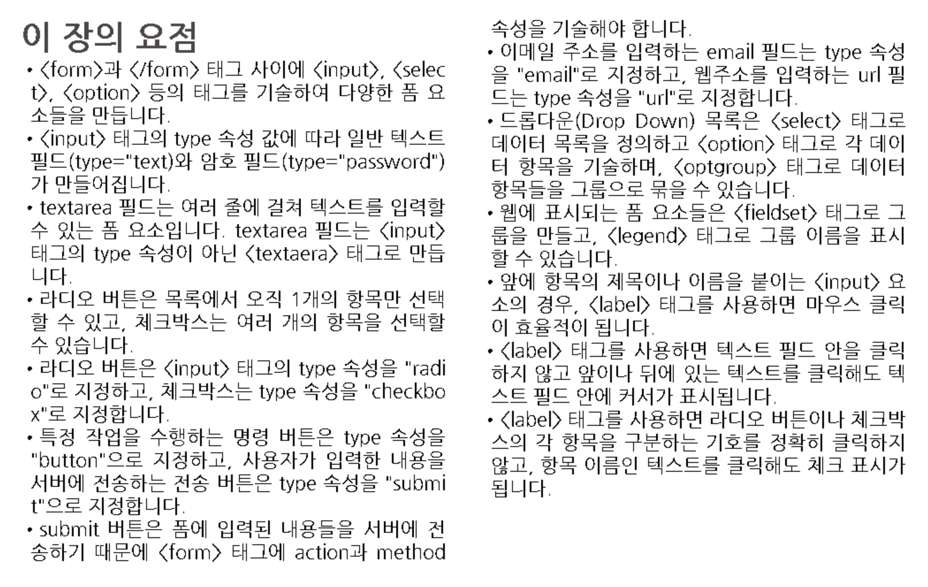

Slide 25
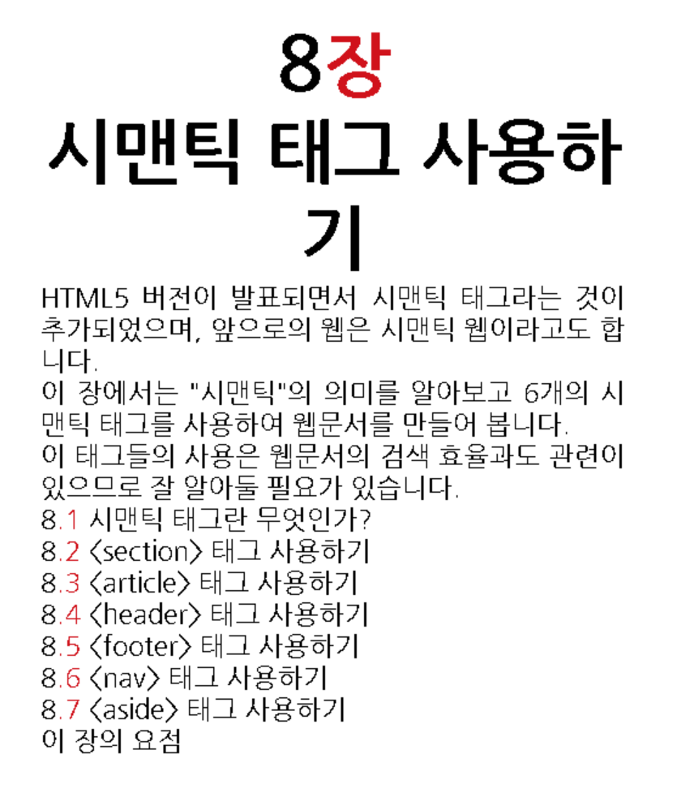

Slide 26
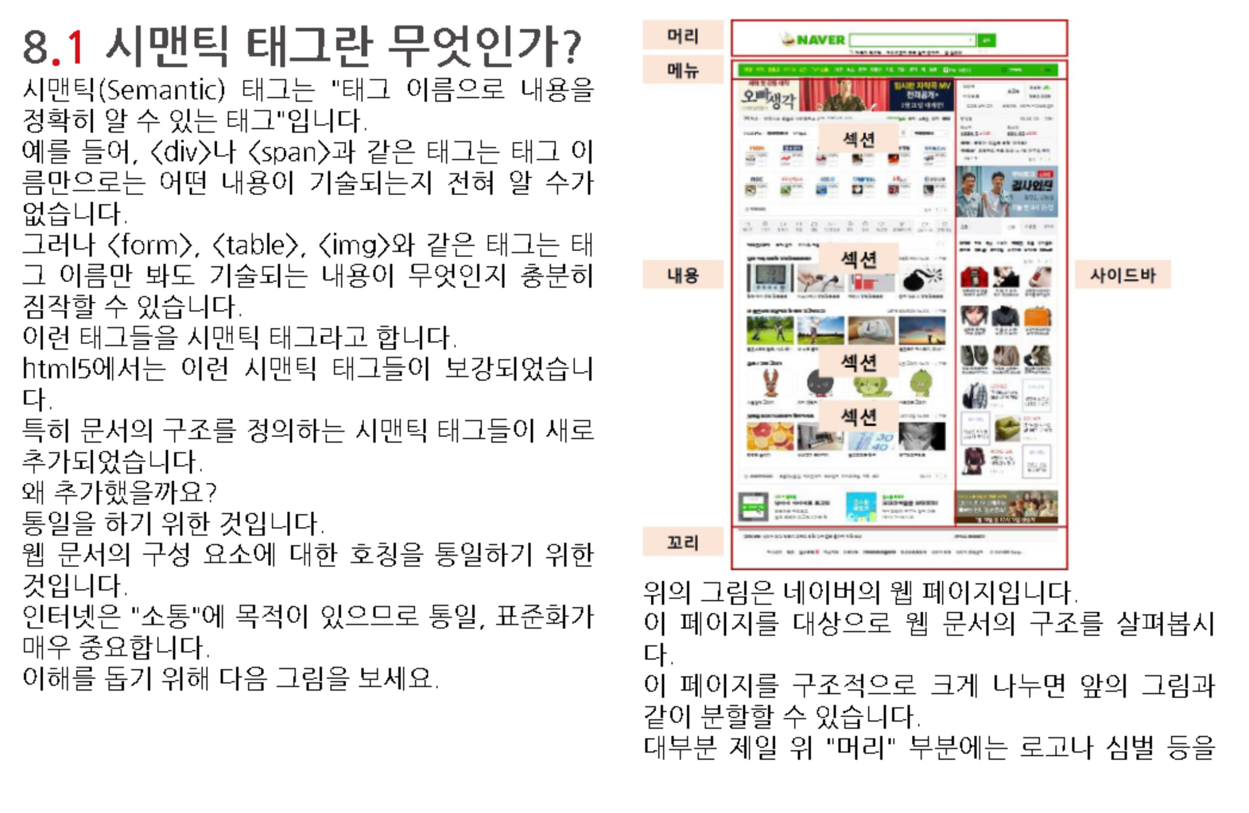

Slide 27
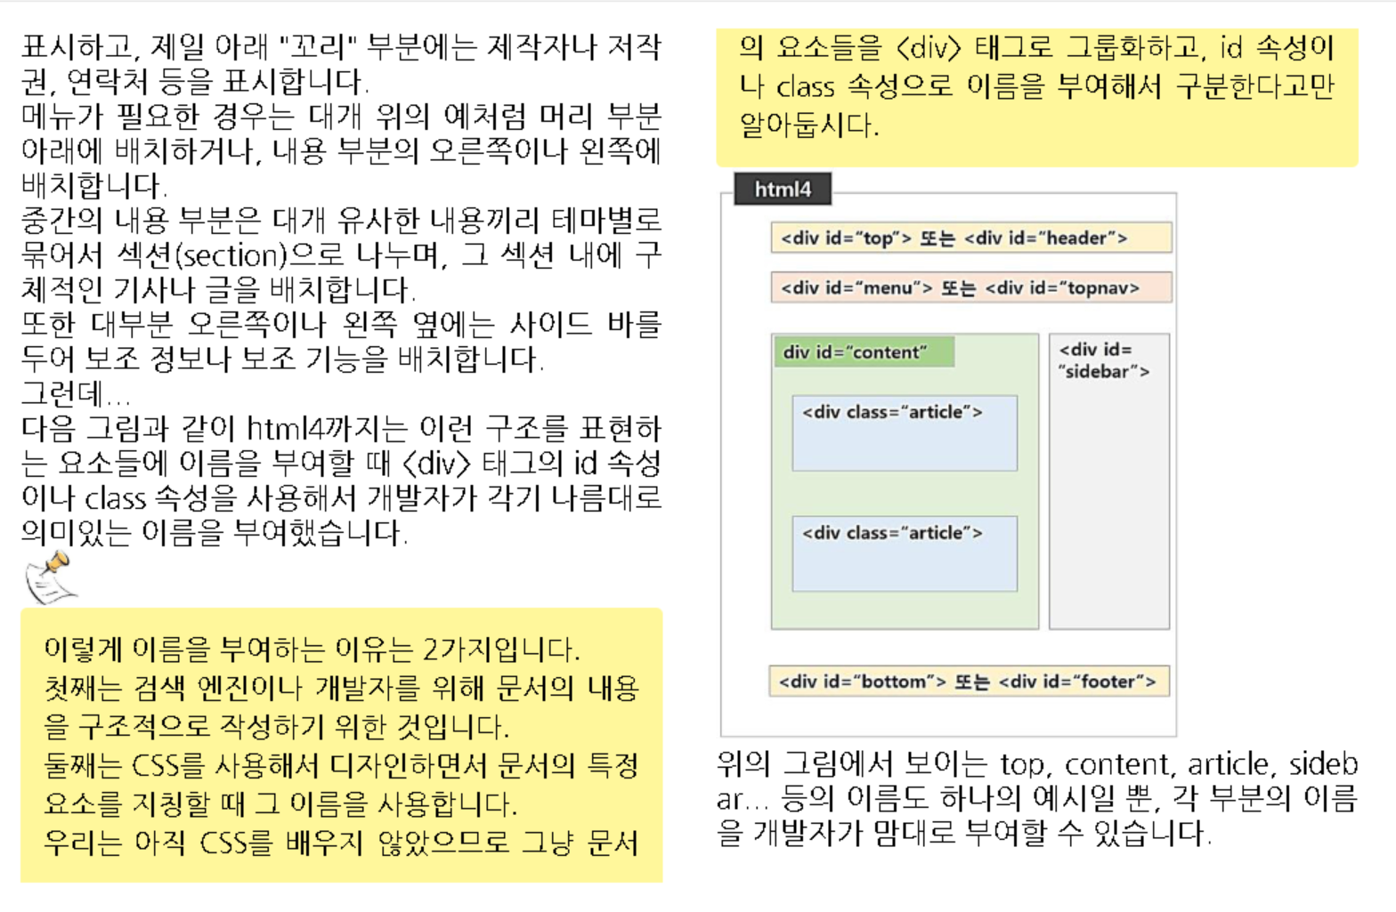

Slide 28
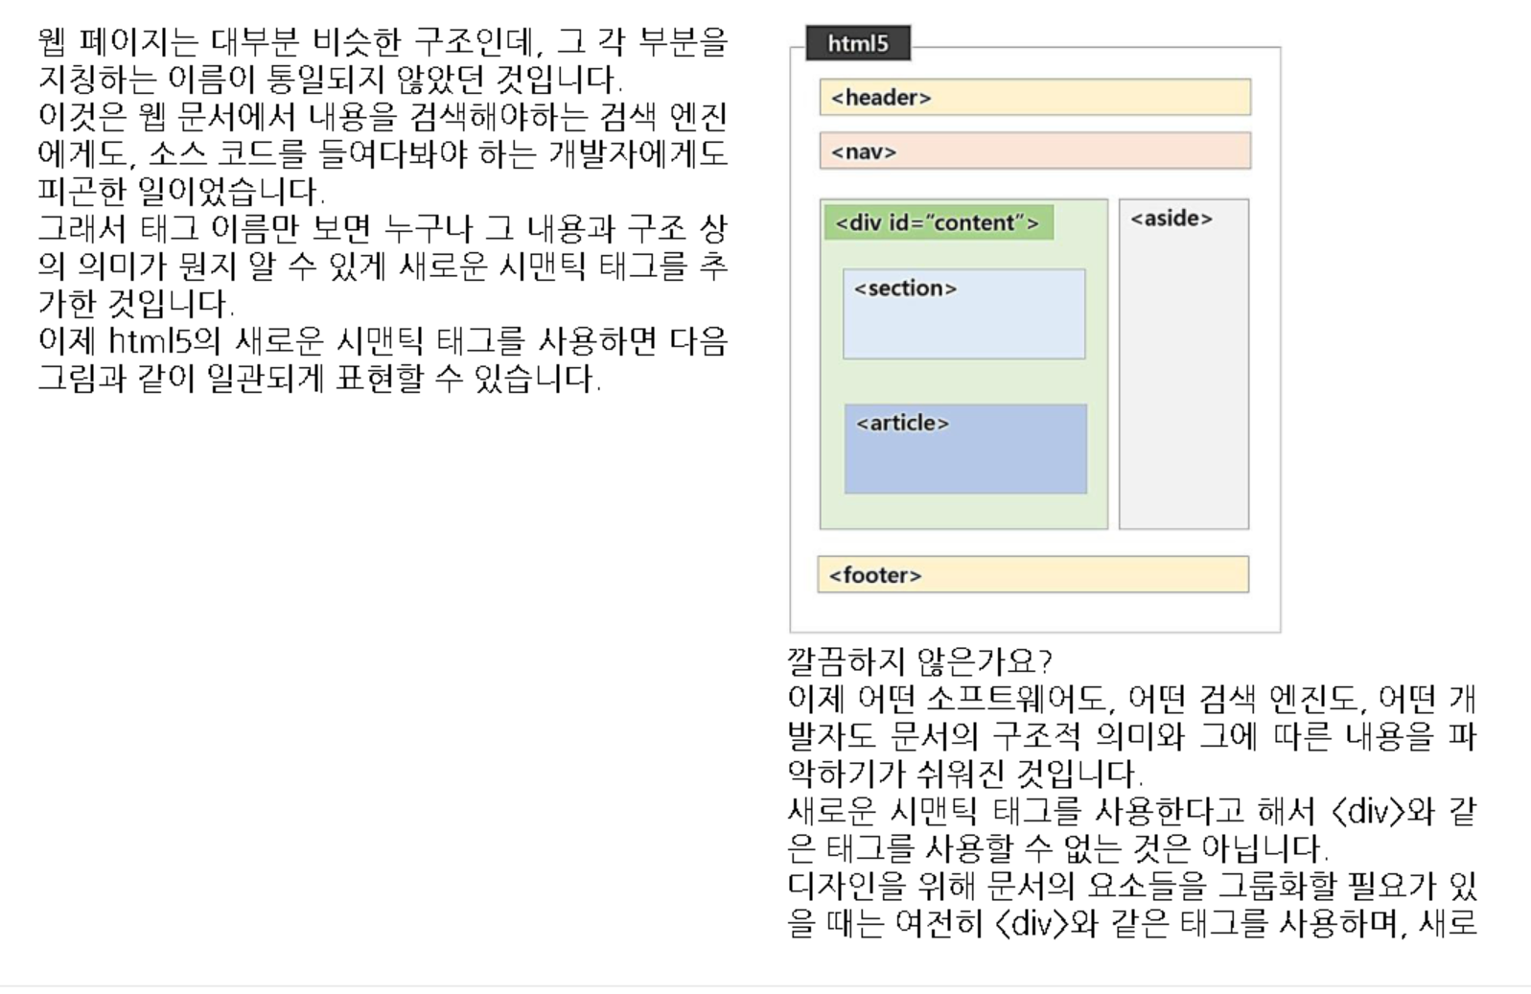
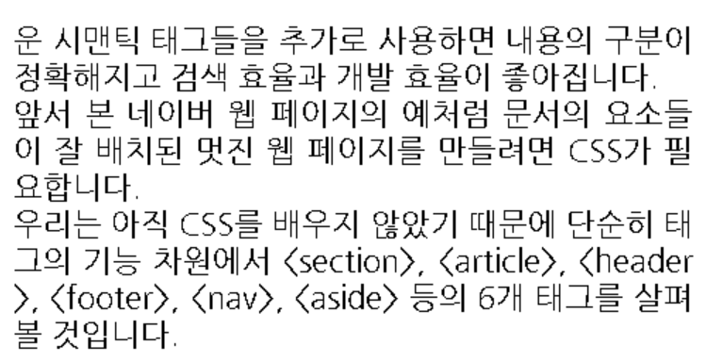

Slide 29
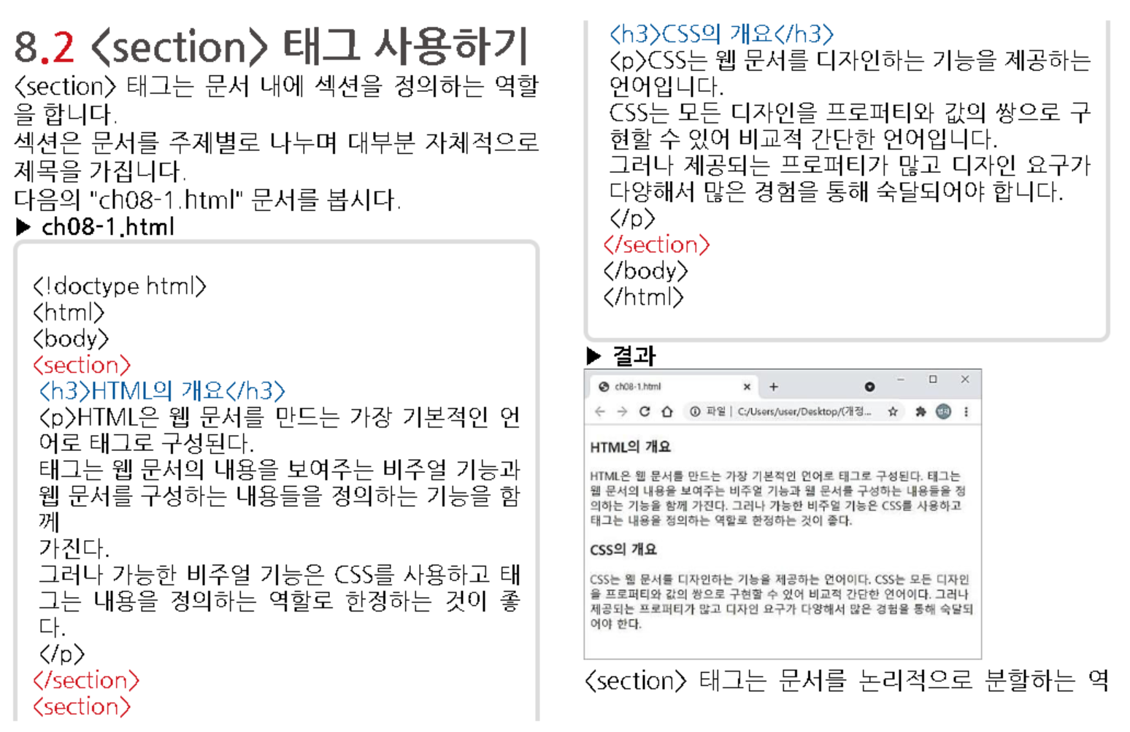
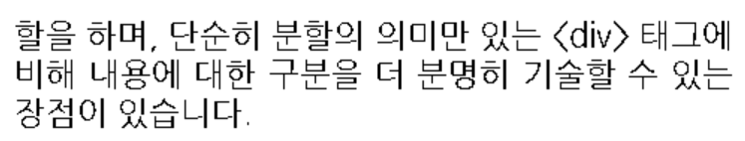

Slide 30
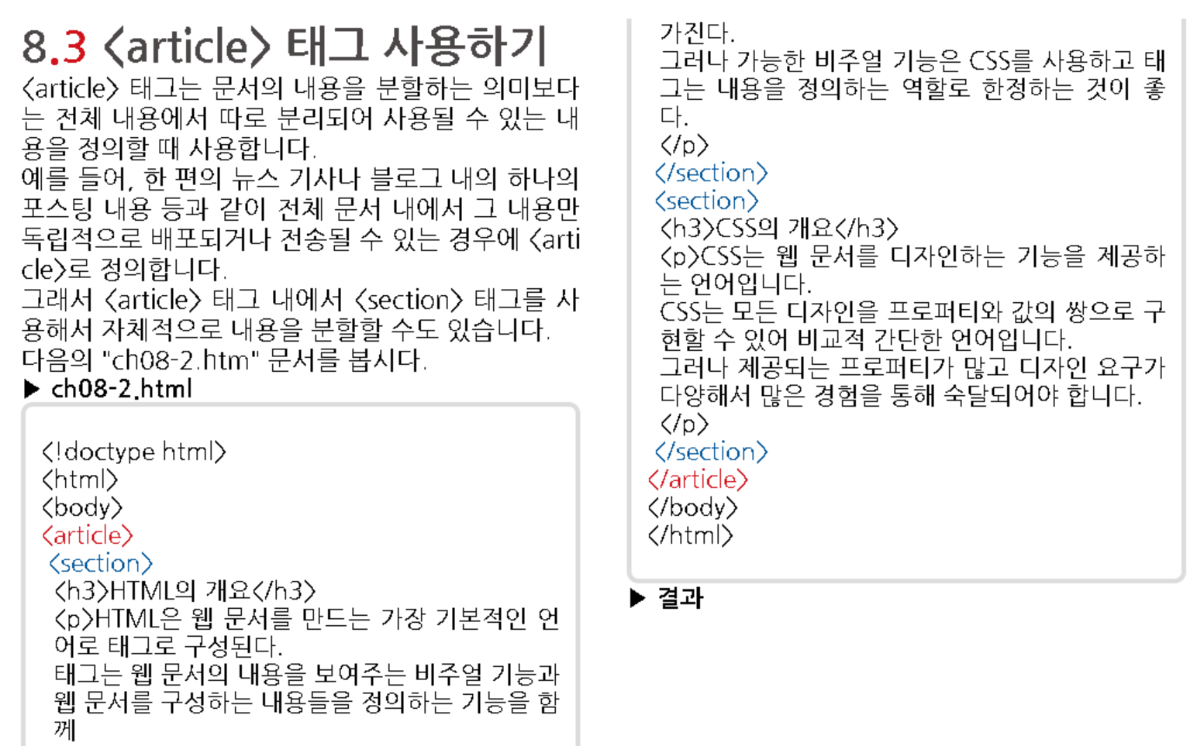

Slide 31
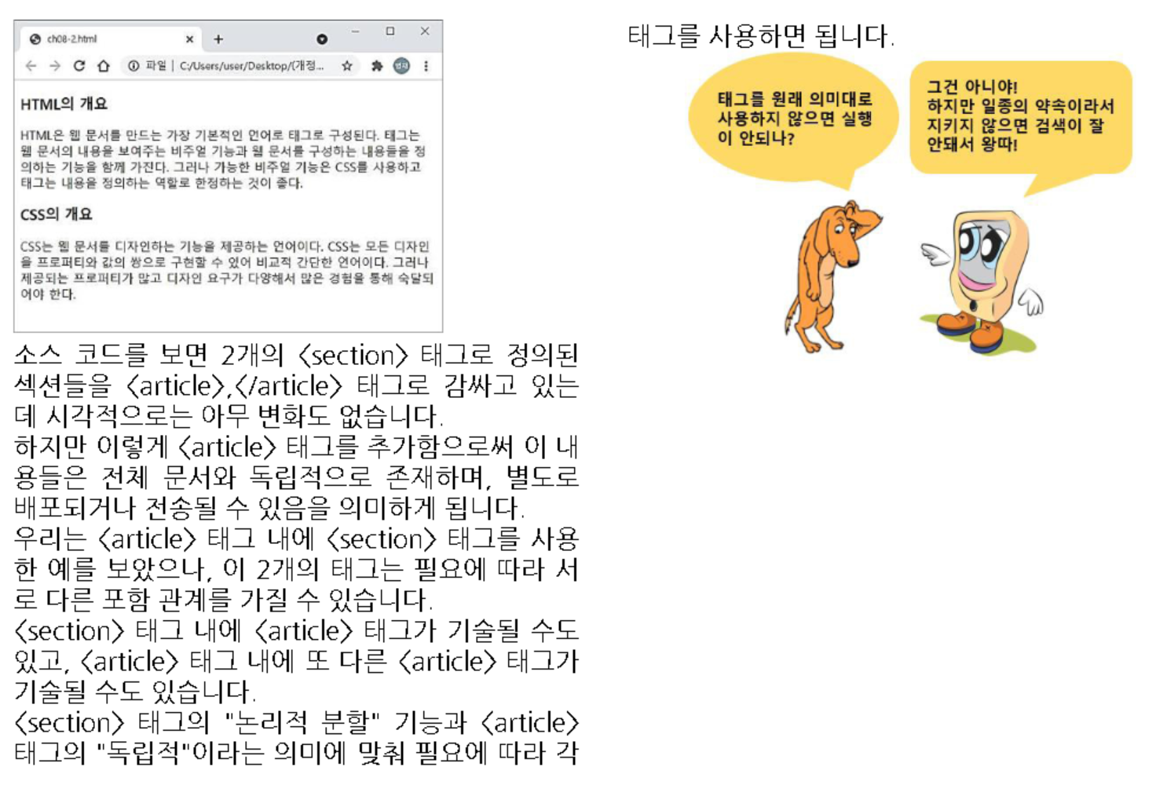

Slide 32
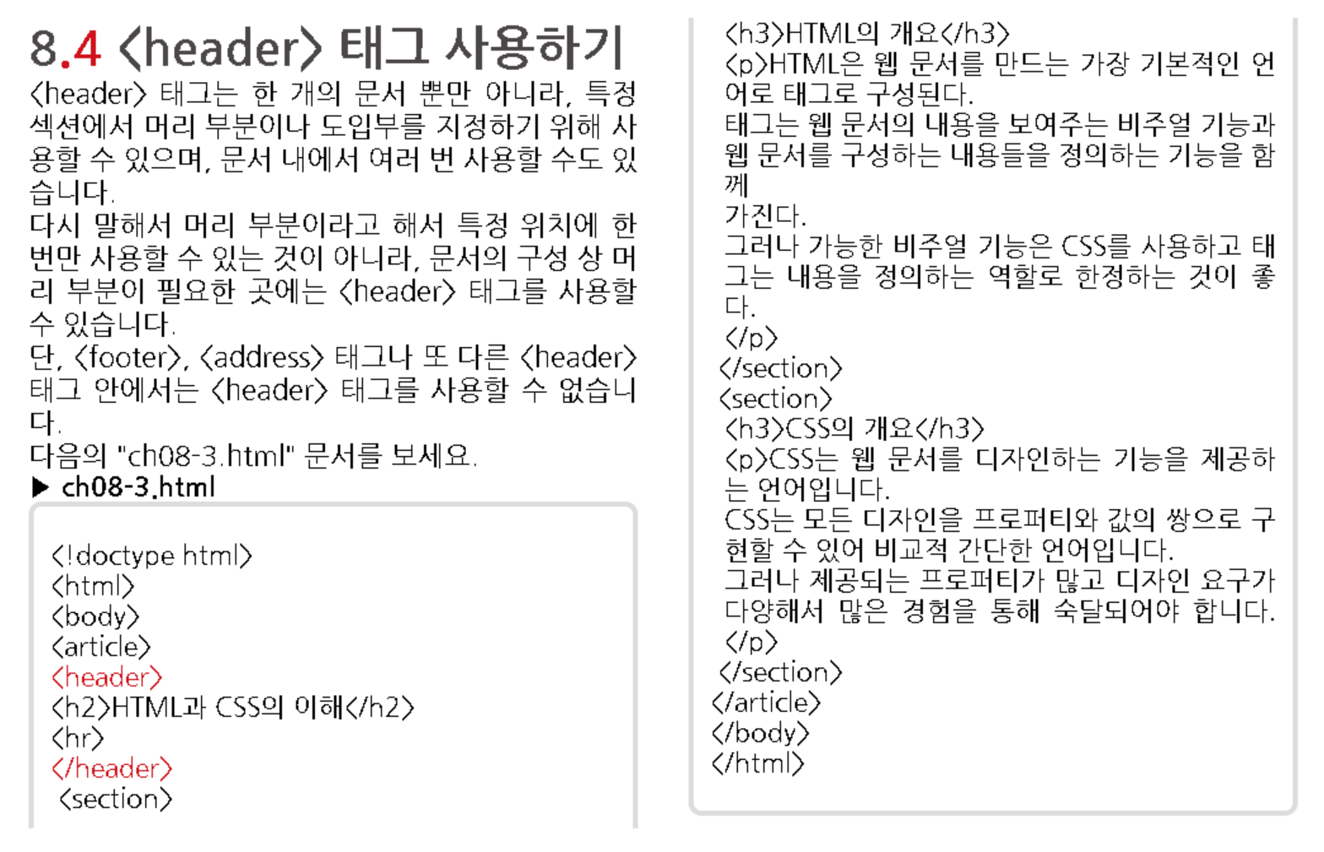
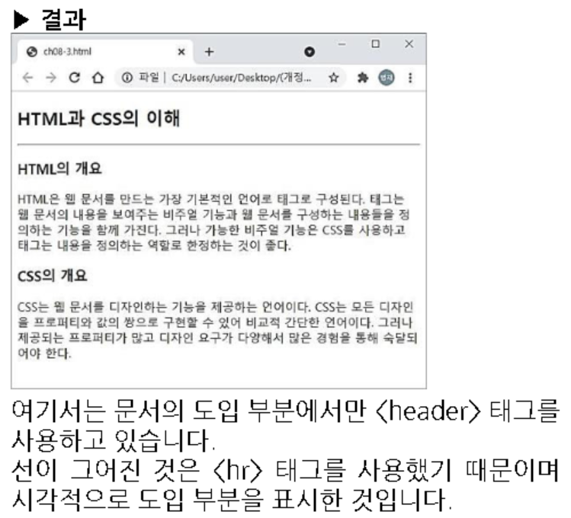

Slide 33
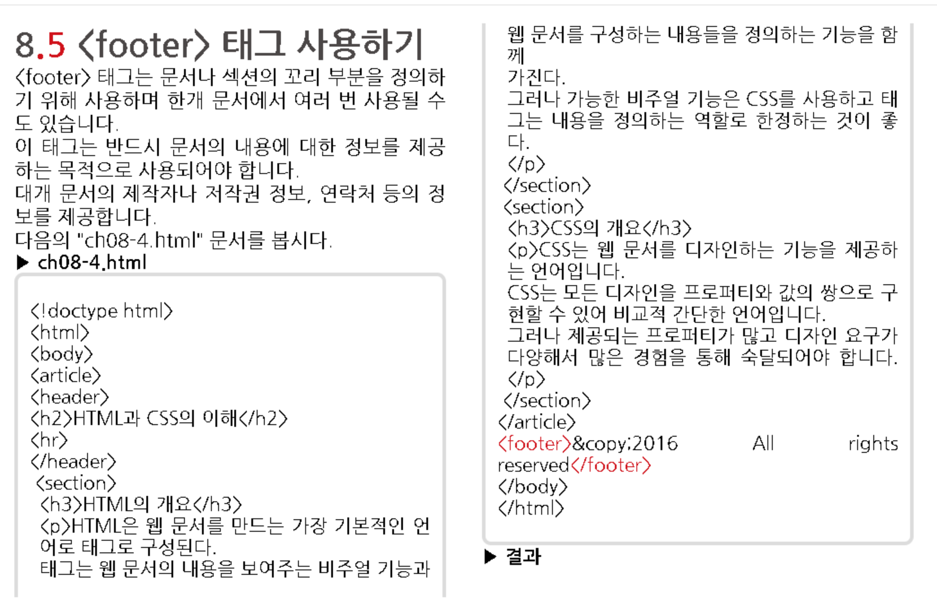
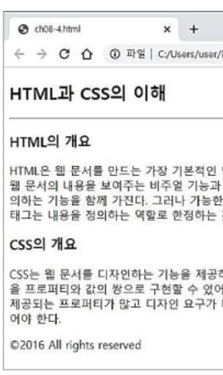

Slide 34
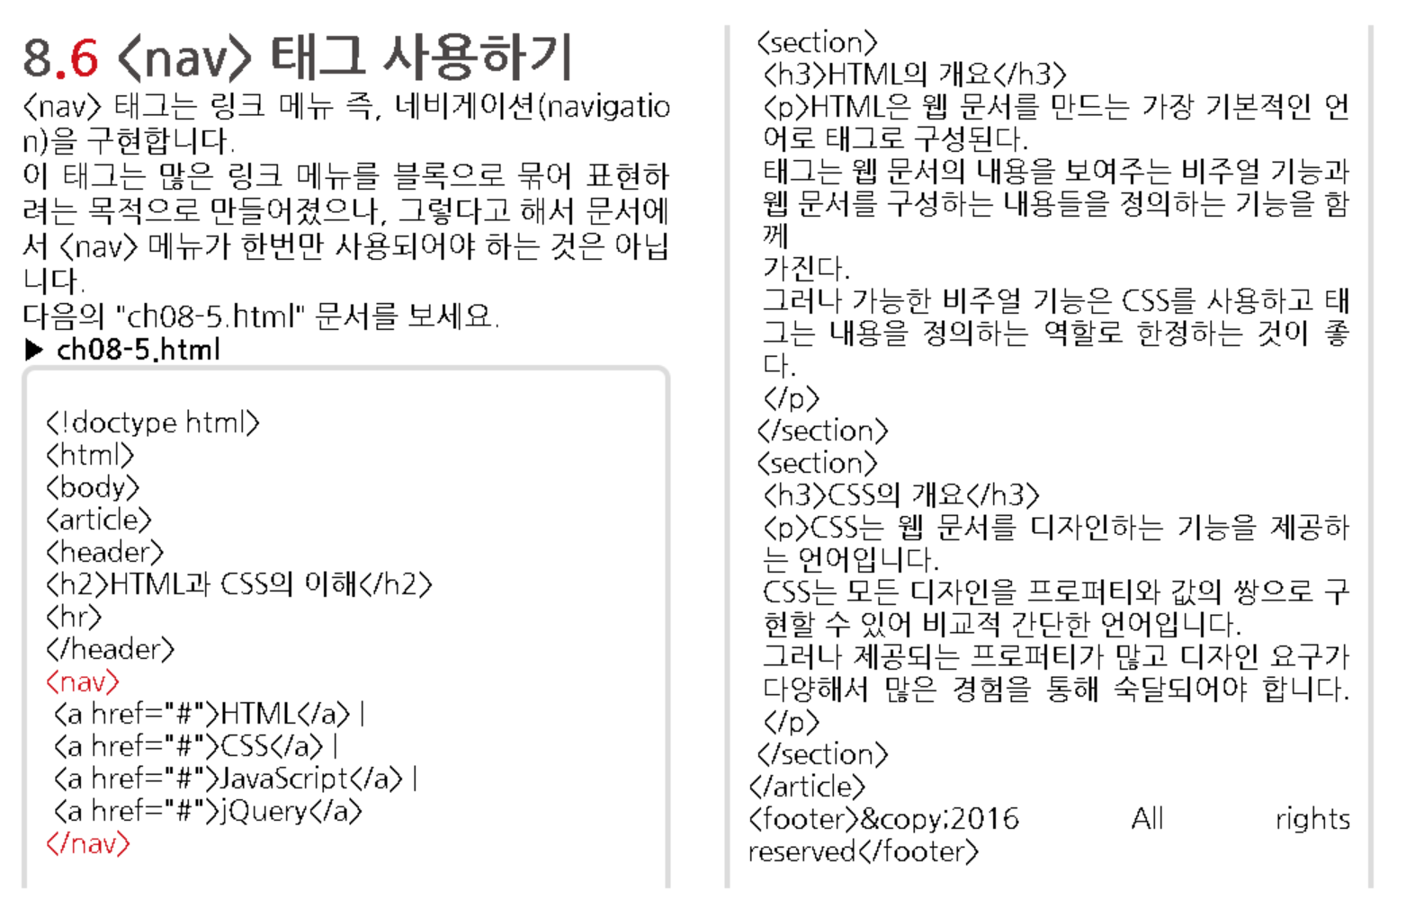
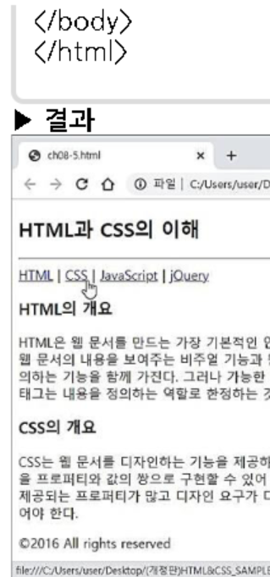

Slide 35
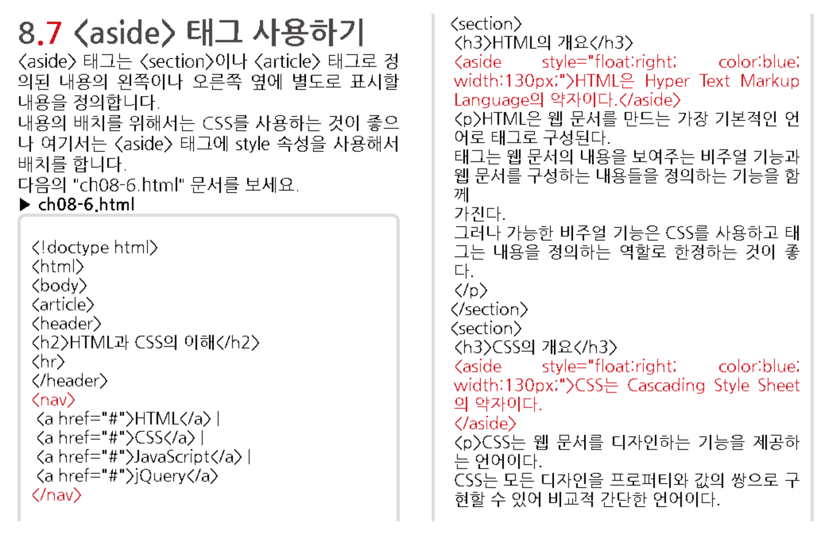

Slide 36
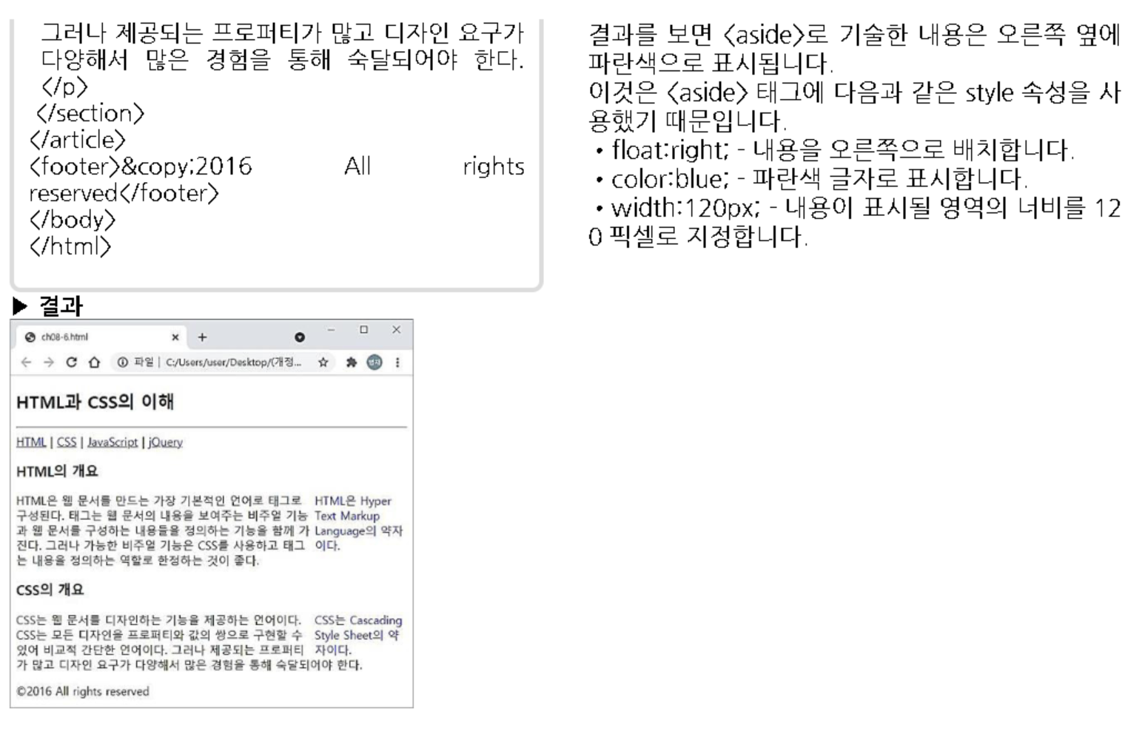

Slide 37
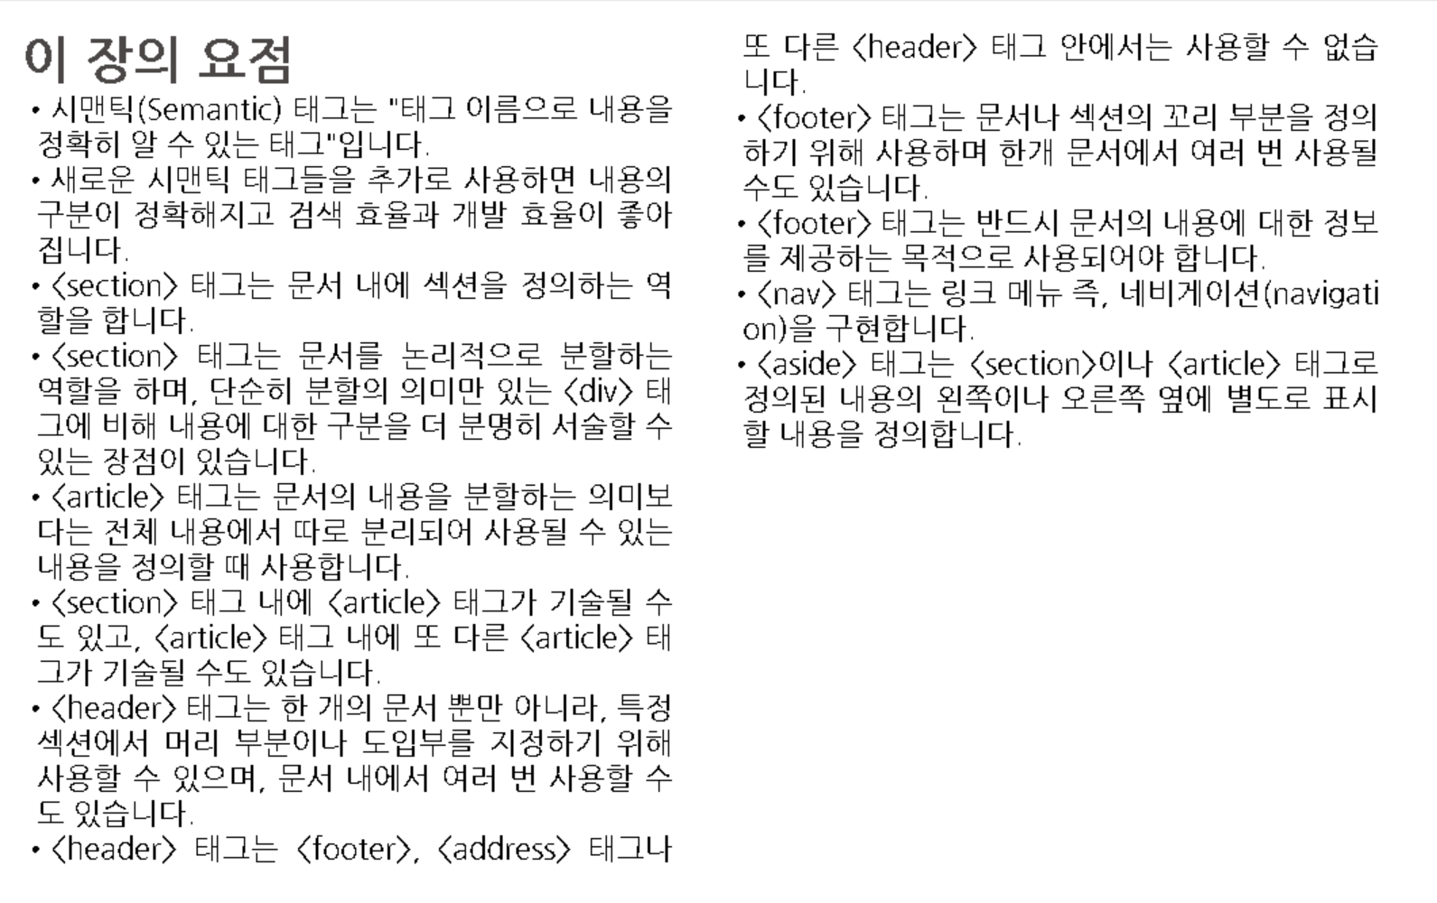

Slide 38
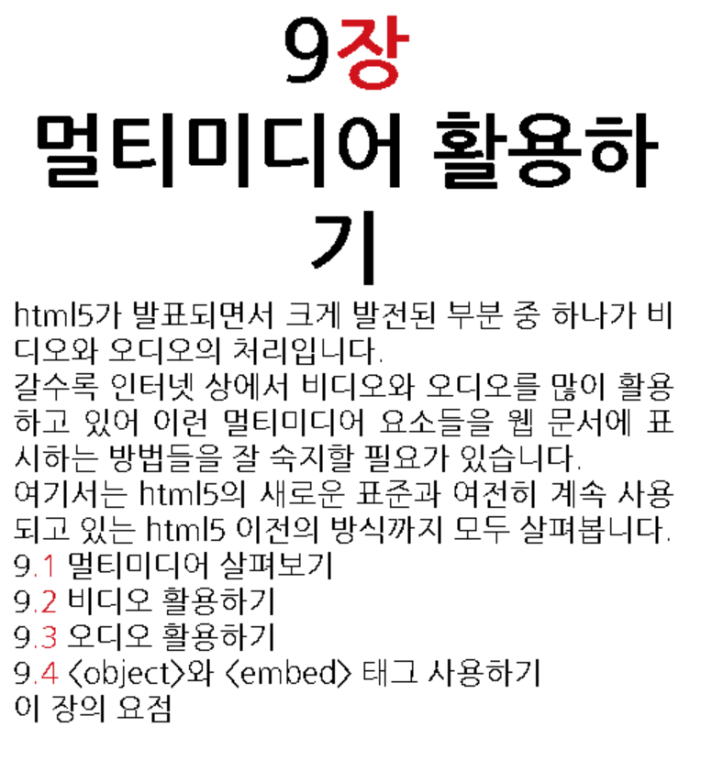

Slide 39
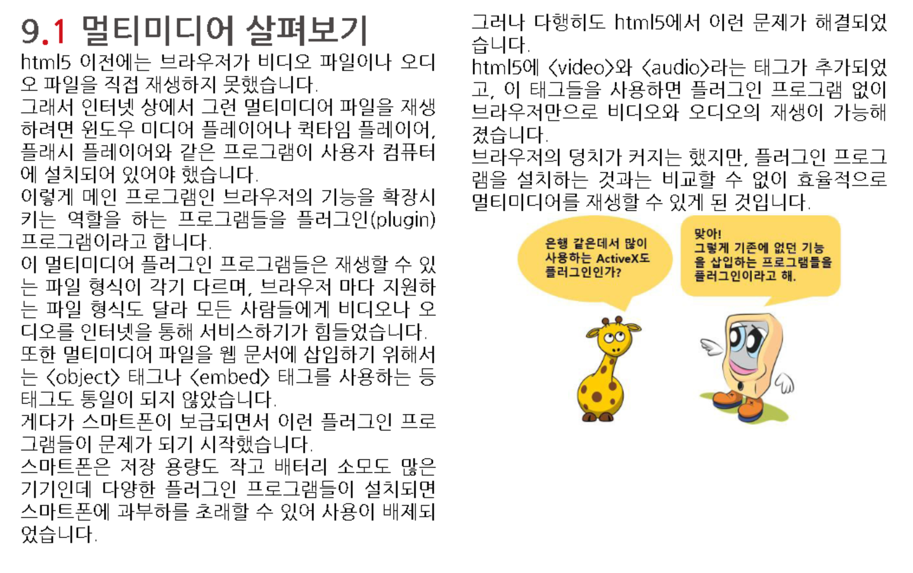

Slide 40
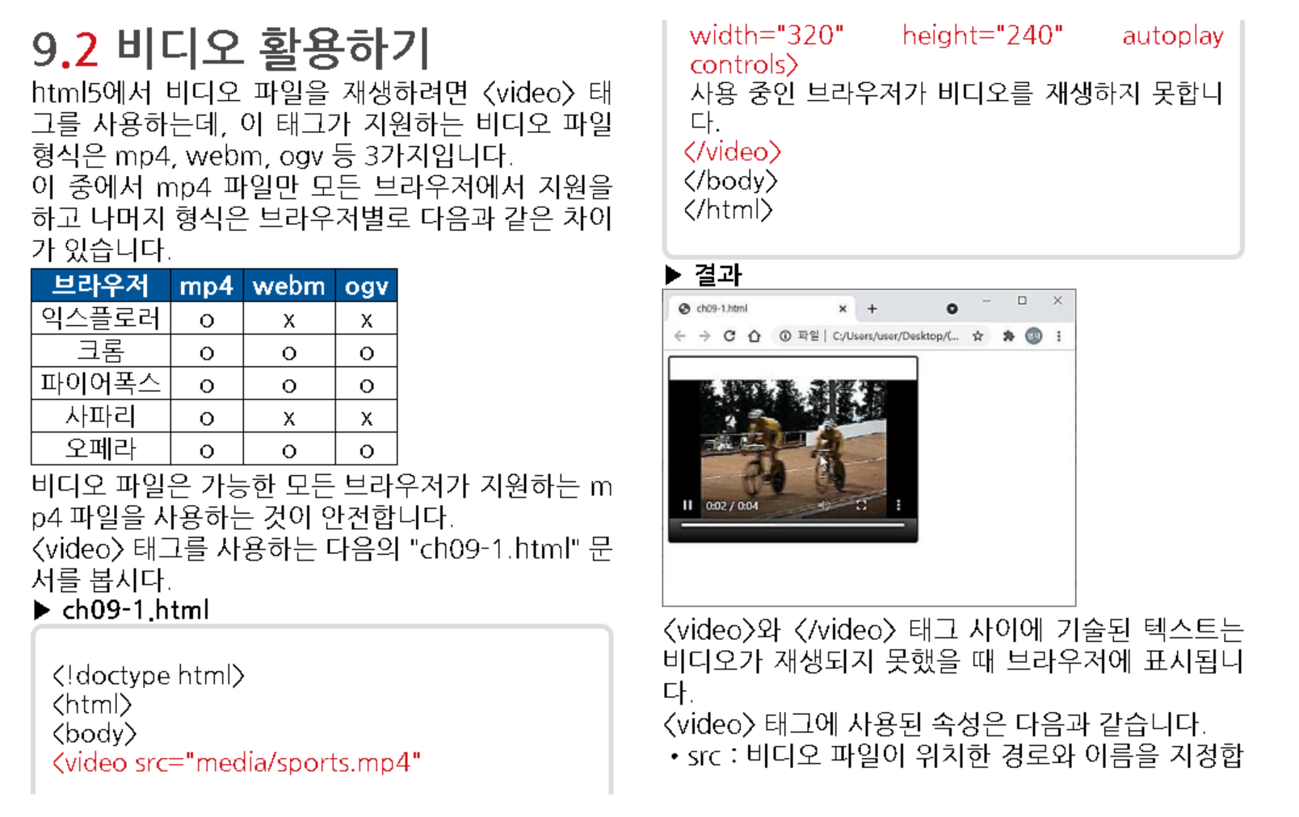

Slide 41
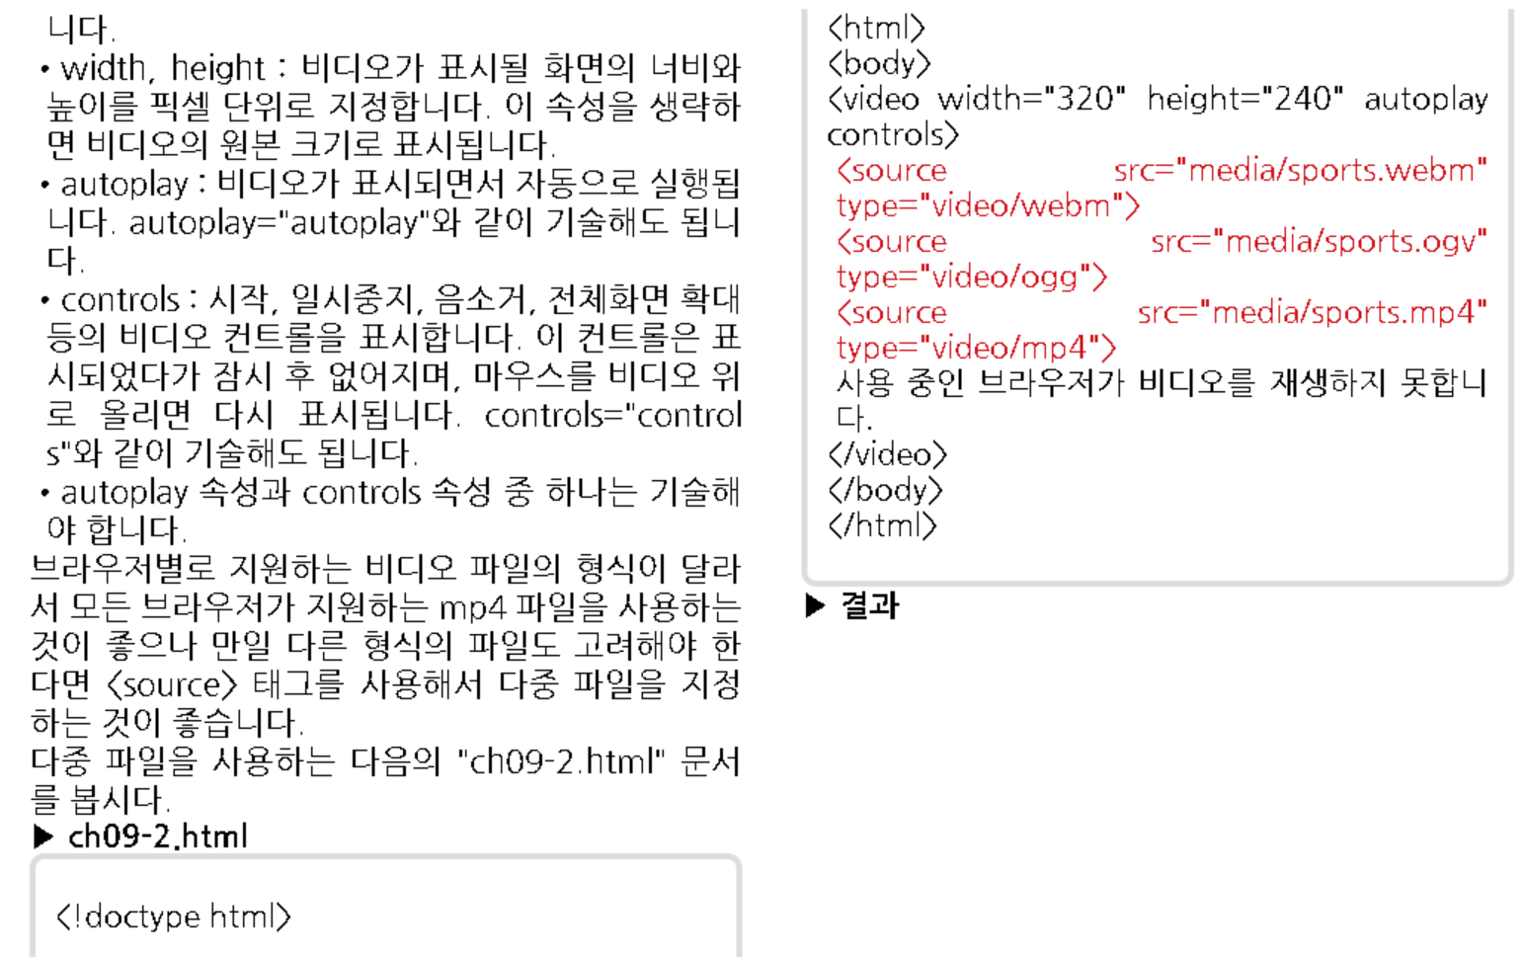

Slide 42
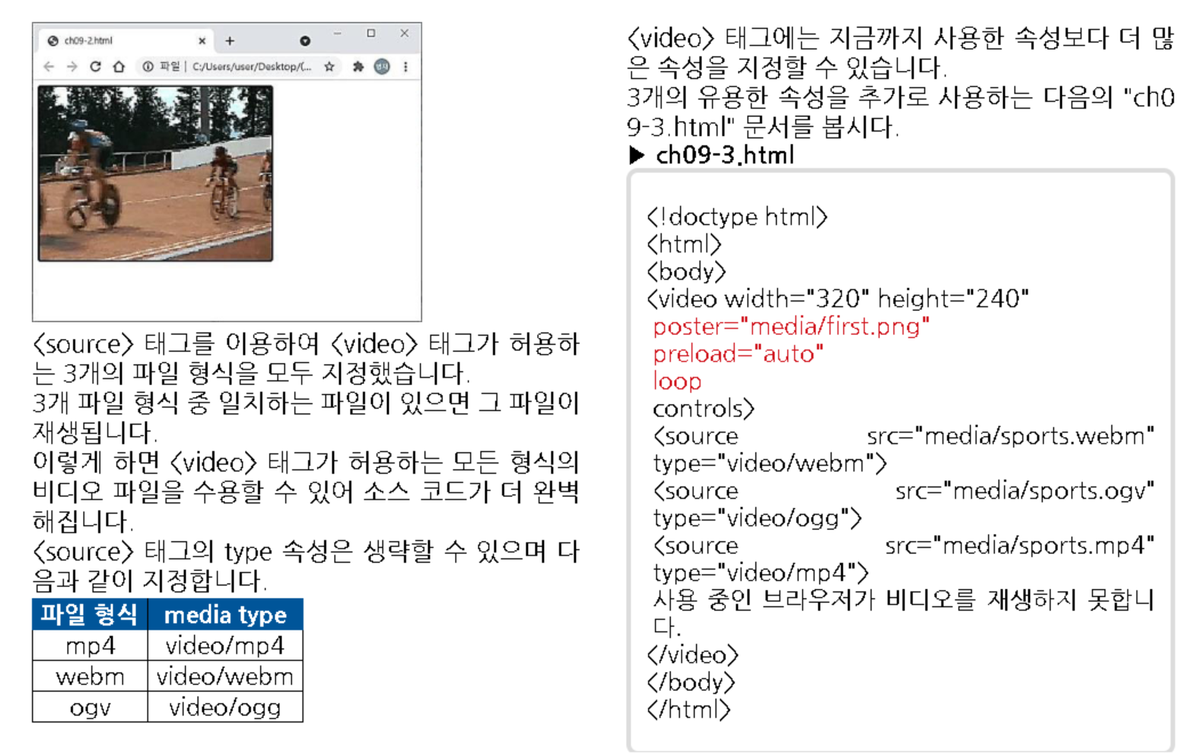

Slide 43
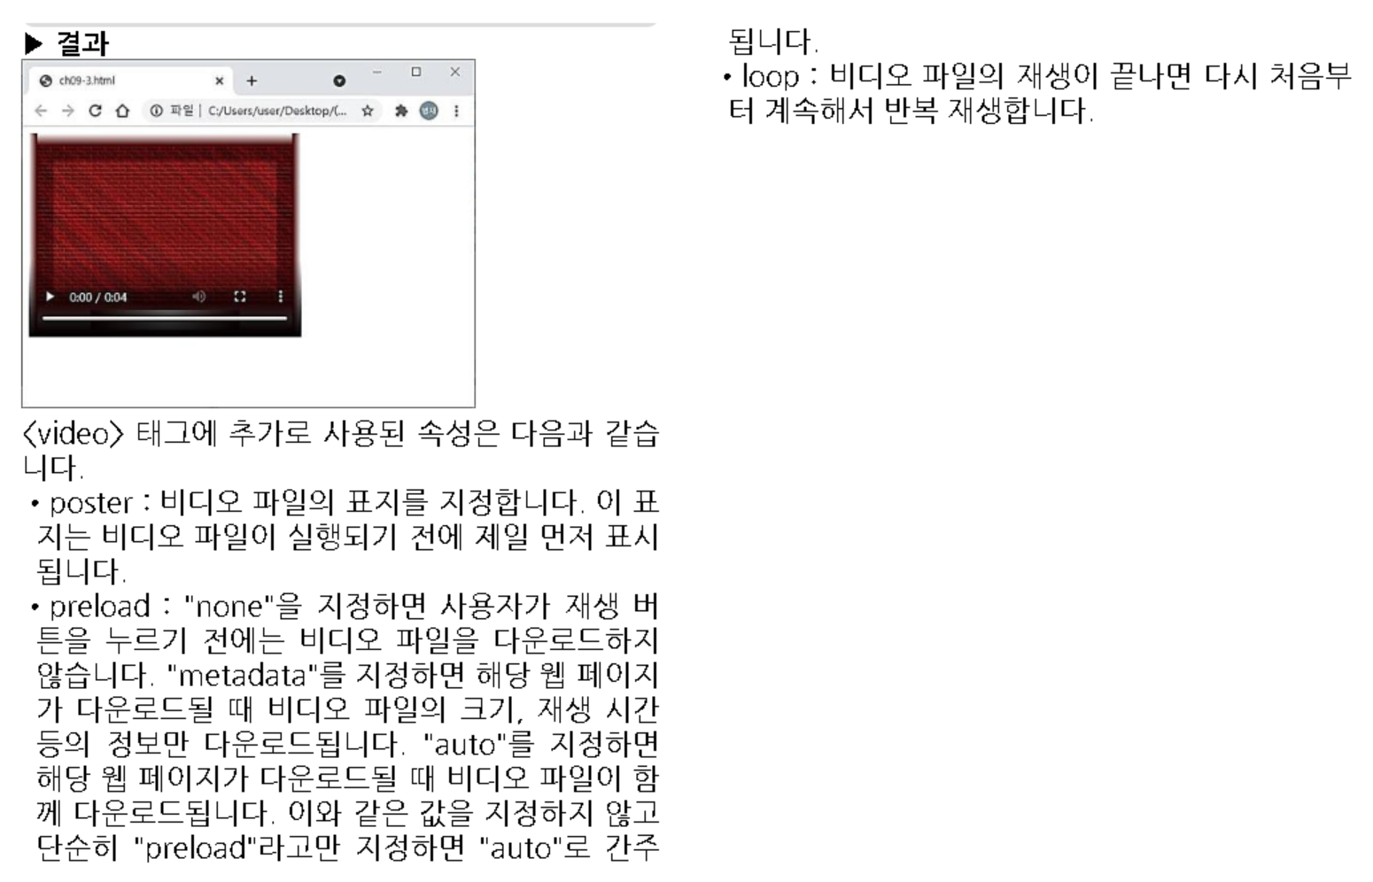

Slide 44
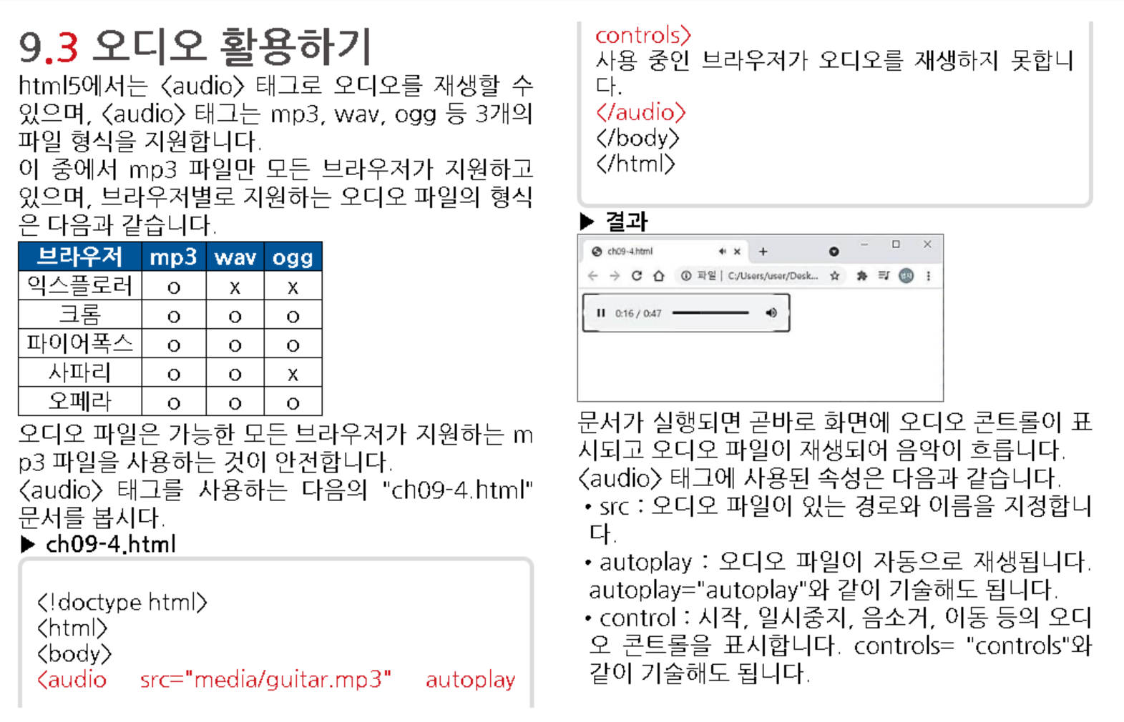

Slide 45
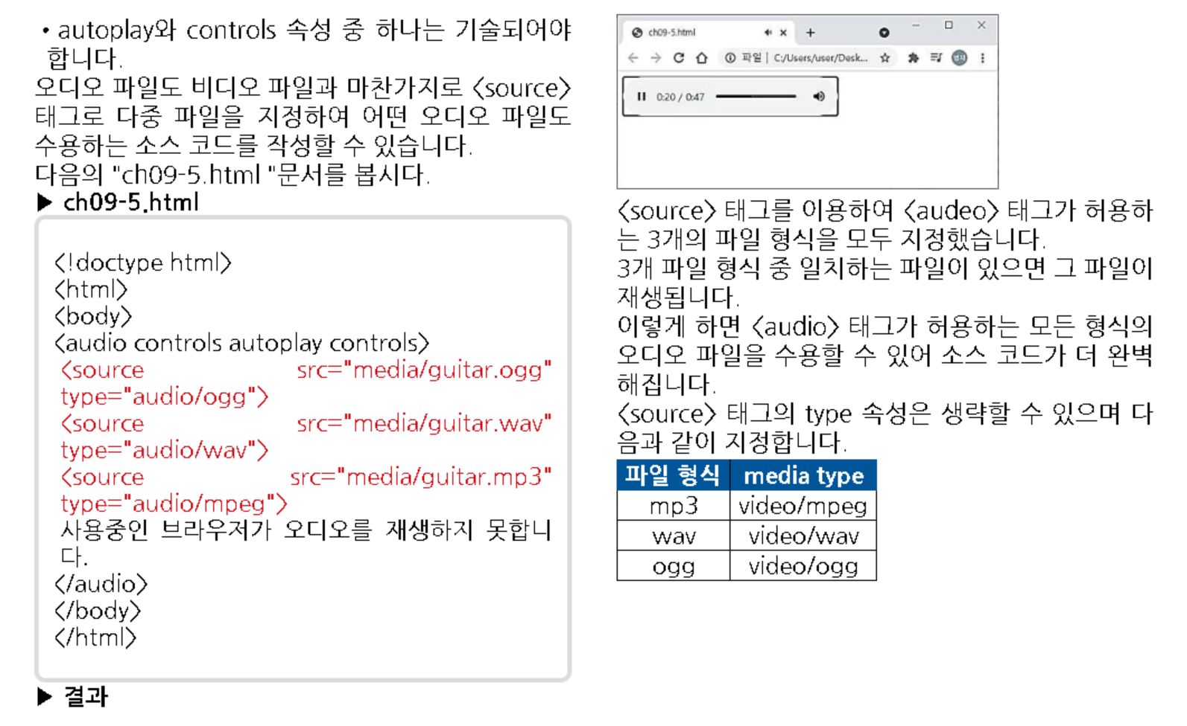

Slide 46
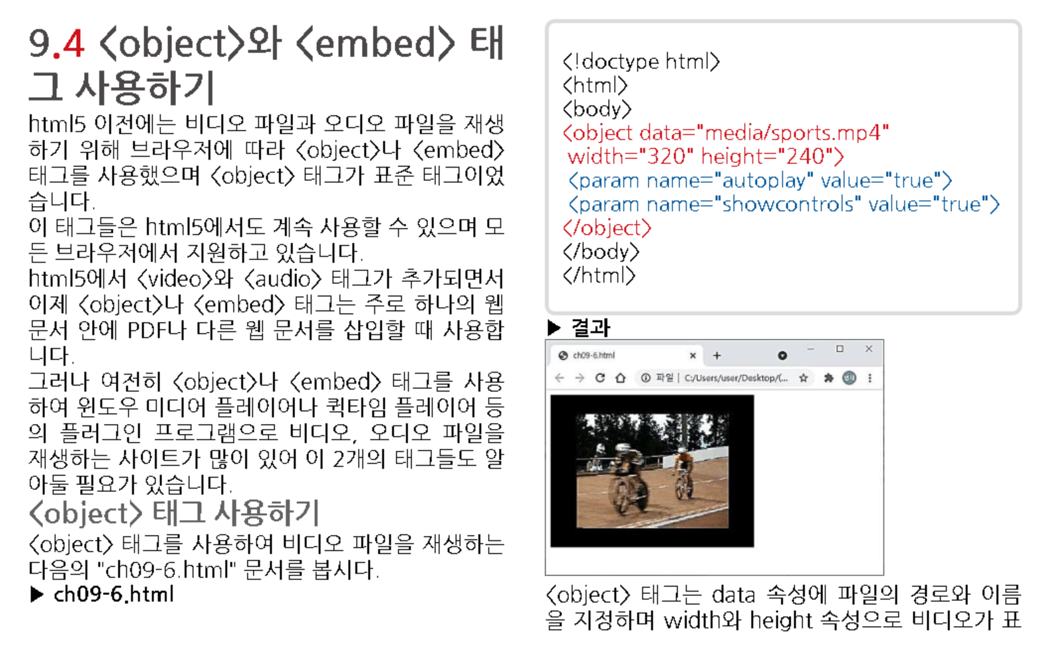

Slide 47


Slide 48



Slide 49



Slide 51


Slide 52


Slide 53


Slide 54


Slide 55


Slide 56


Slide 57


Slide 58


Slide 59


Slide 60


Slide 61


Slide 62


Slide 63


Slide 64


Slide 65


Slide 66


Slide 67


Slide 68



Slide 69


Slide 70


Slide 71


Slide 72



Slide 73


Slide 74



Slide 75


Slide 76


Slide 77




Slide 78


Slide 79


Slide 80


Slide 81


Slide 82


Slide 83





Slide 84



Slide 85


Slide 86



Slide 87



Slide 88


